Slide 1
Using Wireshark
Analyzing EtherCAT and Profinet fieldbus communication packets
Rev. B (updated for EtherCAT)
Oct. 1, 2020
Jimmy Coleman

Slide 2
Overview
Wireshark is a software that records the data of Ethernet and serial communications. We can use it to capture data traces of fieldbus communications. It provides the ability to dissect the communication data packets and analyze the specific parts of concern.
For example, we can capture a trace of EtherCAT communication between a master and a slave. If we were to look at the raw data of an entire Ethernet packet, it would be difficult to determine which part of the data corresponds to the CoE requests and responses. But Wireshark breaks the packet into sections and provides a description of each part of the data. It makes analyzing the fieldbus data much easier and faster.

Slide 3
Wireshark download
Wireshark can be downloaded from the website:
https://www.wireshark.org/

Slide 4
Scope of Training
This training will cover the use of Wireshark for the following fieldbus communication protocols:
EtherCAT
  Filters
  SDO data
  PDO data
Profinet
  Communication verified
  PNU Read/Write (SDO)
  Telegram data (cyclic)

Slide 5
Getting Started with Wireshark
Basic steps for using Wireshark:
Start a Capture
Stop the Capture
Identify the devices
Apply an appropriate Capture Filter
Analyze the data
Since cyclic fieldbus data is transmitted at very high rates, the capture will record thousands of packets within seconds. That is a lot of data to analyze. Because of this, it is best to run the capture for the shortest amount of time as possible. Start and stop the capture quickly at the appropriate times to capture the necessary events.

Slide 6

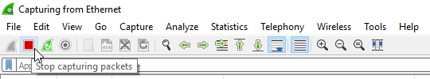


Capture Controls
The main capture controls are “Start”, “Stop”, “Pause”, and “Start new without saving”.

Slide 7
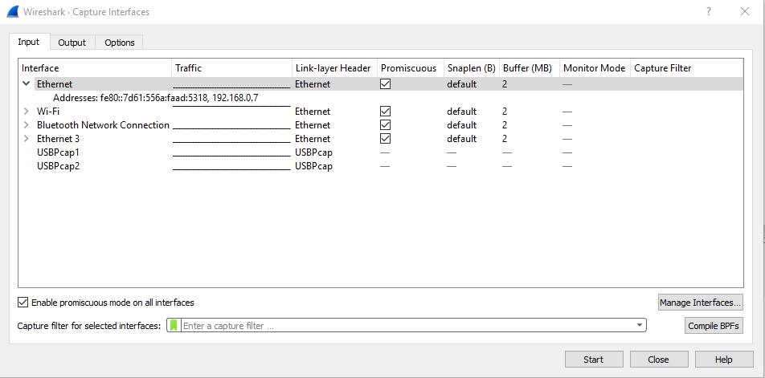
Select Ethernet Port
Click “Capture Options” to select the appropriate interface (Ethernet adapter).
“Promiscuous” means that data packets on an Ethernet port are visible to all software interfaces on the PC.
TwinCAT must be set to “Promiscuous Mode” so Wireshark (installed on the same PC as TwinCAT) can see the packets sent between the TwinCAT software and the EtherCAT slave devices.

Slide 8
Network Topology
Wireshark can be installed on the same PC as the EtherCAT master or on a separate PC on the EtherCAT network.
Master
With
Wireshark
Master
Unmanaged Switch
Slave
Slave
Slave
Slave
Laptop
With Wireshark
Slave
Slave
“Promiscuous” means that data packets on an Ethernet port are visible to all software interfaces on the PC.
TwinCAT must be set to “Promiscuous Mode” so Wireshark (installed on the same PC as TwinCAT) can see the packets sent between TwinCAT and the EtherCAT slave devices.
The Ethernet switch must be unmanaged, so that it will relay all data to all ports of the switch. If it is managed, the EtherCAT data will not be seen by the laptop.

Slide 9
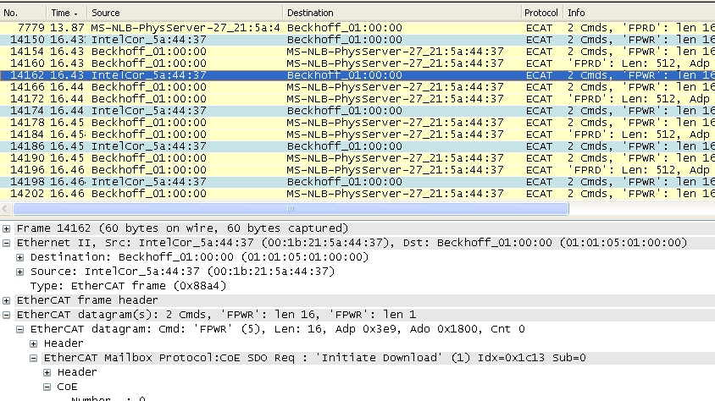
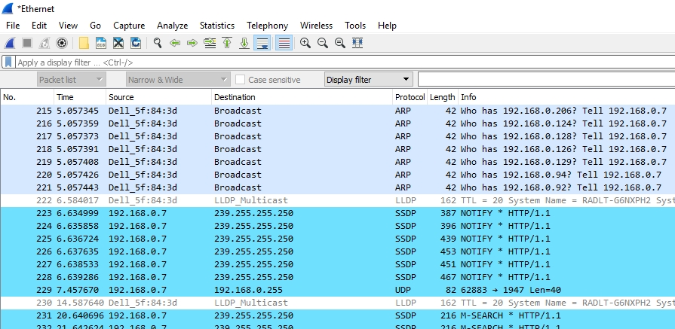
Wireshark Capture
EtherCAT
Internet

Slide 10
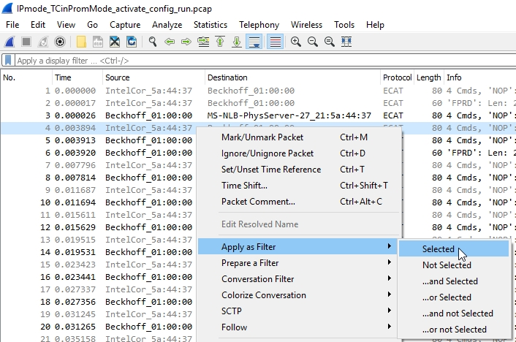
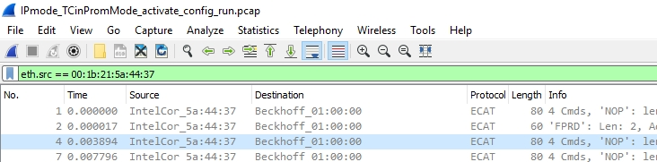
Filters: Ethernet Source
Setting the filter to “eth.src == 00:1b:21:5a:44:37” (with your device MAC Address) will display only the packets set from that device (for example, all packets from EtherCAT Master).
Or right-click on a packet and select “Apply as Filter -> Selected”.

Slide 11
Filters: EtherCAT Datagrams
There are 2 datagram filters that are the most useful in analyzing EtherCAT CoE data:
Filter: “ecat_mailbox” – mailbox data (SDO), both directions
Filter: “ecat.cmd==12” – PDO data, both directions
Keep in mind that most of what we are interested in looking at in Wireshark is the CoE SDO’s and PDO’s. Other filters can be used to see other types of EtherCAT datagrams.
Filter: “ecat” – shows all EtherCAT datagram traffic

Slide 12
Filters: Other Datagram Types
Filter: “ecat.cmd==5”
– FPWR “Configured Address Write”, Master to Slave
– Sync manager, Distributed Clock, Mailbox data (SDO), etc.
Filter: “ecat.cmd==4”
– FPRD “Configured Address Read”, Slave to Master
– Sync manager, Distributed Clock, Mailbox data (SDO), etc.
Filter: “ecat.cmd==7” – Broadcast
Filter: “ecat.cmd==8” – Broadcast
Filter: “ecat.ado” or “ecat.adp” – slave address
https://wiki.wireshark.org/Protocols/ethercat

Slide 13
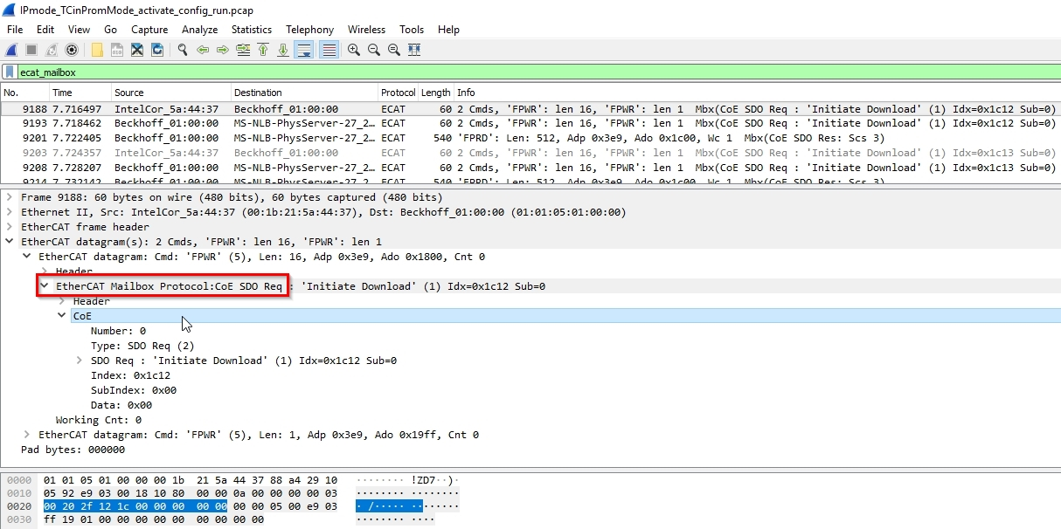
Filters: EtherCAT Mailbox (SDO)
Setting the filter to “ecat_mailbox” will display only the EtherCAT Mailbox (SDO) packets.

Slide 14
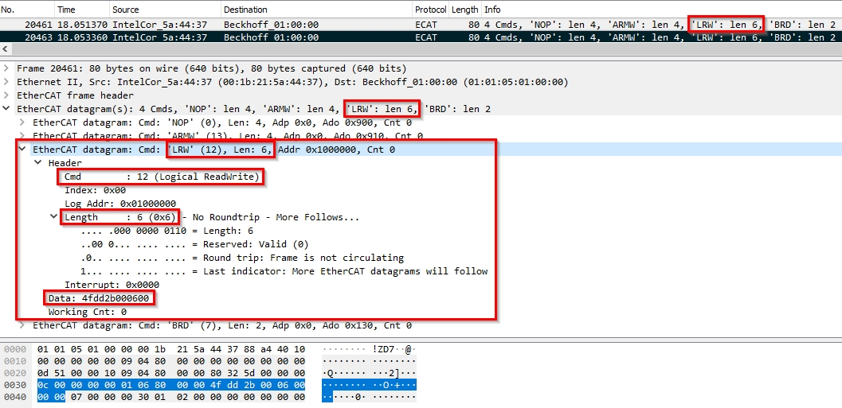
Filters: EtherCAT PDO data
EtherCAT PDO data is transmitted via Ethernet packets using the “LRW” (Logical Read Write) command type. LRW is command type #12, so you can apply a filter for EtherCAT command #12 to display only EtherCAT packets with PDO data.
“ecat.cmd == 12” - displays all packets with PDO data (EtherCAT datagram Cmd = 'LRW’)
Combining filters gives the flexibility of displaying only PDO data from the master or from the slave:
“eth.src == 00:1b:21:5a:44:37 && ecat.cmd ==12” - packets with PDO data sent from Master
“eth.src == 01:01:05:01:00:00 && ecat.cmd ==12” - packets with PDO data sent from a particular Slave

Slide 15
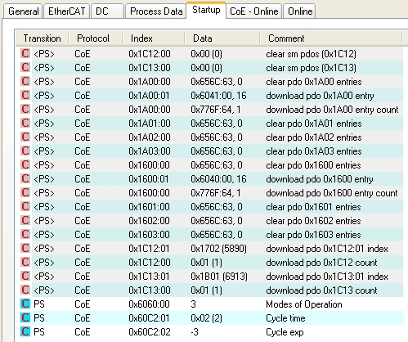
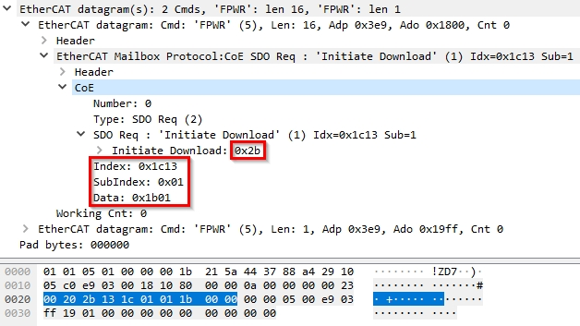
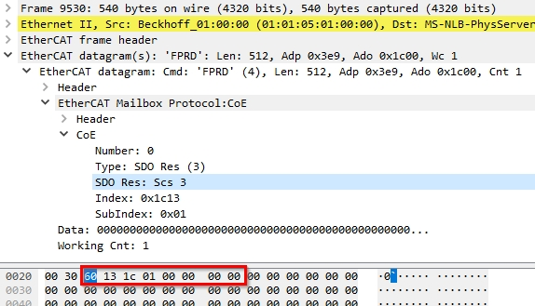
EtherCAT SDO’s (Mailbox)
EtherCAT SDO’s (Mailbox) are typically sent upon initialization of the EtherCAT master program. These are found in the Startup tab in TwinCAT. They will be sent each time the Activate Configuration command is executed in TwinCAT.

Slide 16
CoE (CANopen) Data
Most of what we use Wireshark for is to look at the CoE (CANopen) data.
We want to see what is being sent to the drive and how the drive responds.
This is the same as using PCAN Explorer to capture and analyze CANopen traces.

Slide 17
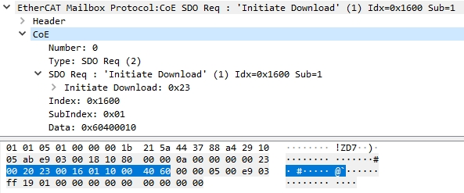
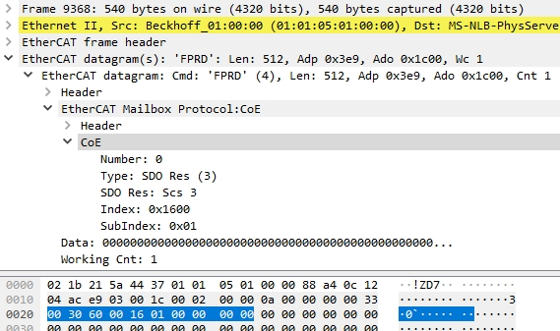
CoE (CANopen) Data: SDO Example
Example of using Wireshark to analyze CoE (CANopen over EtherCAT) data:
SDO Request – Master to Slave
SDO Response – Slave to Master
CANopen data: 23 00 16 01 10 00 40 60
Write 4 bytes
Object 1600 subindex 1
Data: 60400010 – object 6040, 2 bytes of PDO data
Configuring PDO assignment 1600 for Control Word (object 6040) and 2 bytes of data.
Response contains a “60” meaning successful.

Slide 18
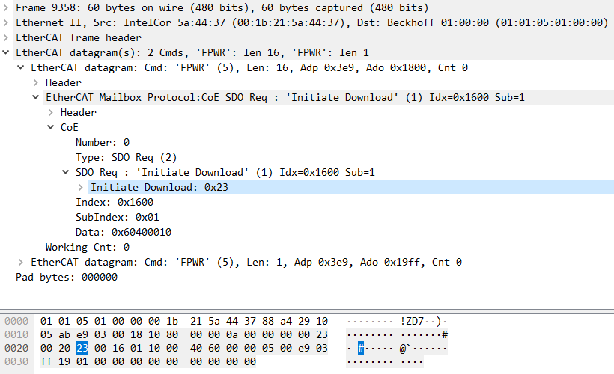
CoE (CANopen) Data: SDO Example
Example of using Wireshark to analyze CoE (CANopen over EtherCAT) data: Data size

Slide 19
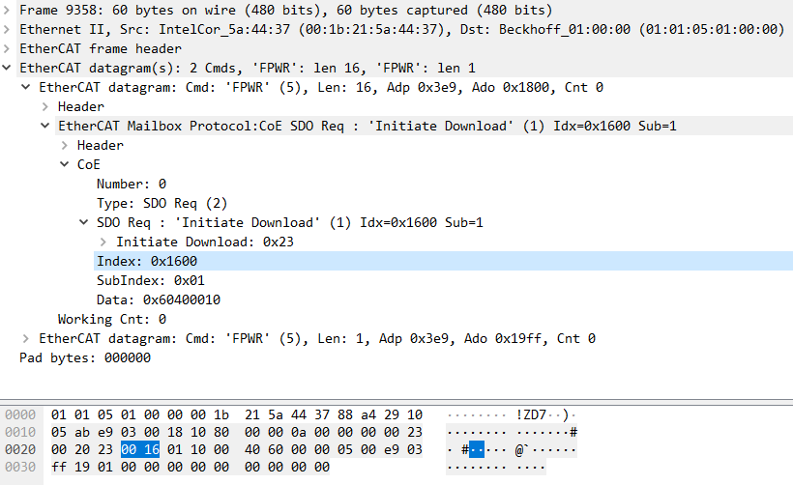
CoE (CANopen) Data: SDO Example
Example of using Wireshark to analyze CoE (CANopen over EtherCAT) data: Object number

Slide 20
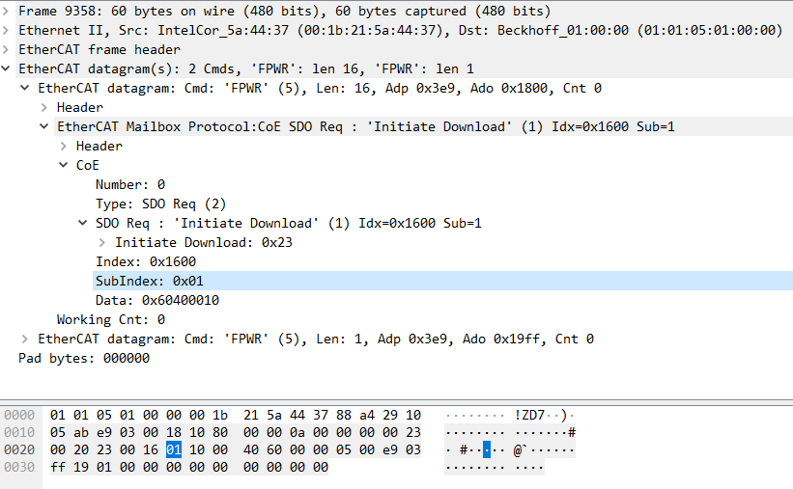
CoE (CANopen) Data: SDO Example
Example of using Wireshark to analyze CoE (CANopen over EtherCAT) data: Subindex

Slide 21
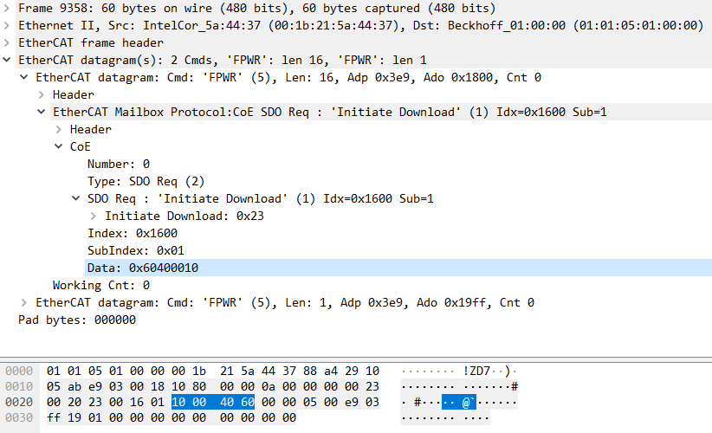
CoE (CANopen) Data: SDO Example
Example of using Wireshark to analyze CoE (CANopen over EtherCAT) data: Data value

Slide 22
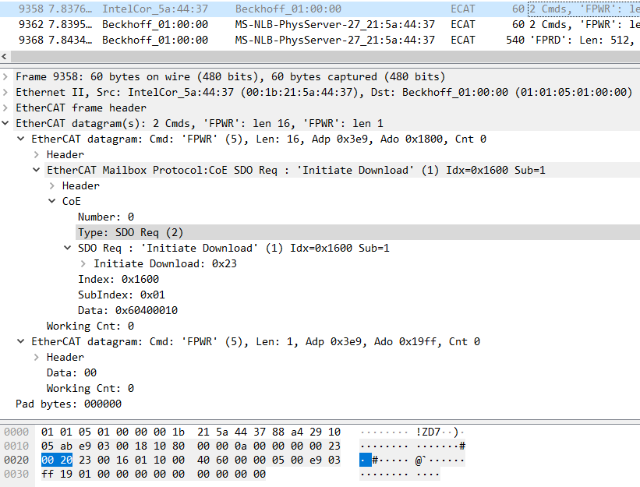
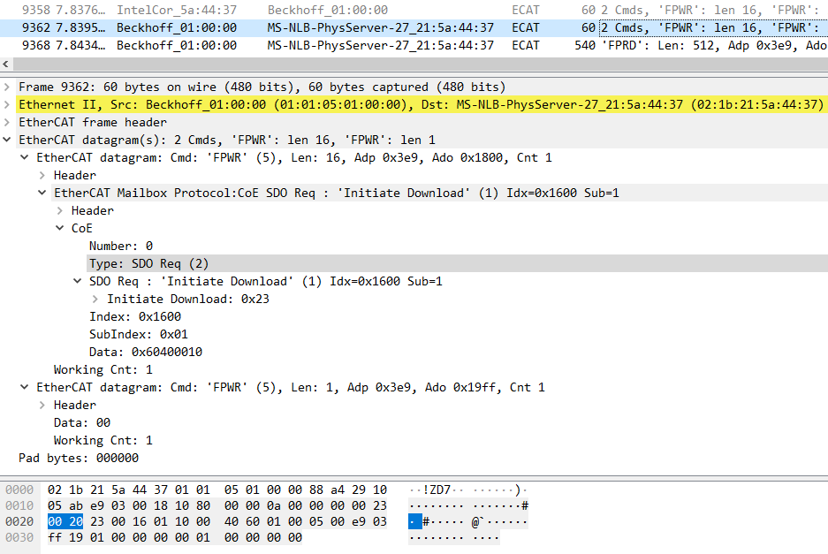
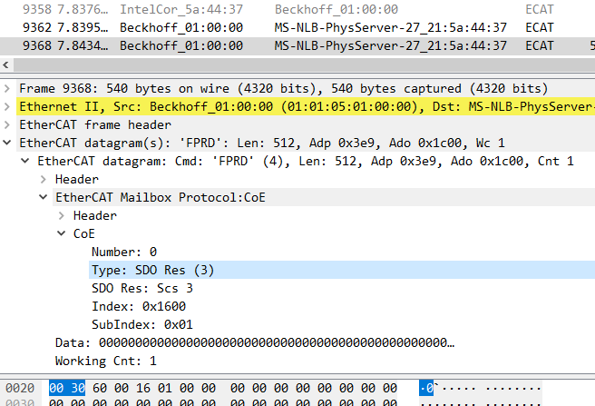
TwinCAT Source & Destination
IntelCor (TwinCAT PC processor) → Beckhoff (Ethernet Port)
Beckhoff (Ethernet Port) → MS-NLB-PhysServer (Microsoft Windows - TwinCAT)
  “SDO Req”: Echo of packet sent from Master to Slave
  “SDO Res”: Packet returned from Slave to Master
SDO Request – Master to Slave
SDO Request – Echo
SDO Response – Slave to Master

Slide 23
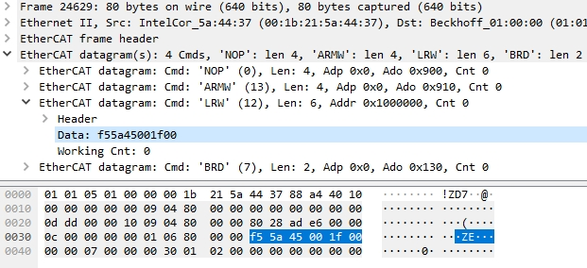

CoE (CANopen) Data: PDO Example
Example of using Wireshark to analyze CoE (CANopen) data:
CANopen TxPDO data: 00 1F 00 45 5A F5
Control Word = 0x001F
Target Position = 0x00455AF5
CANopen RxPDO data: 12 37 00 44 7B 45
Status Word = 0x1237
Actual Position = 0x00447B45

Slide 24
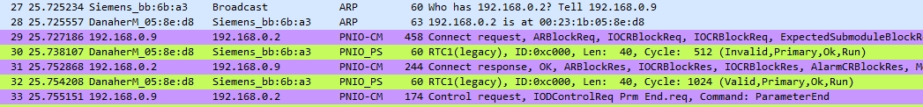
Profinet Communication
When Profinet communication is being established between the PLC and the slave device, the PLC will issue a series of requests and the slave will respond.
You can look at these requests and responses in Wireshark to verify that they were successful.

Slide 25
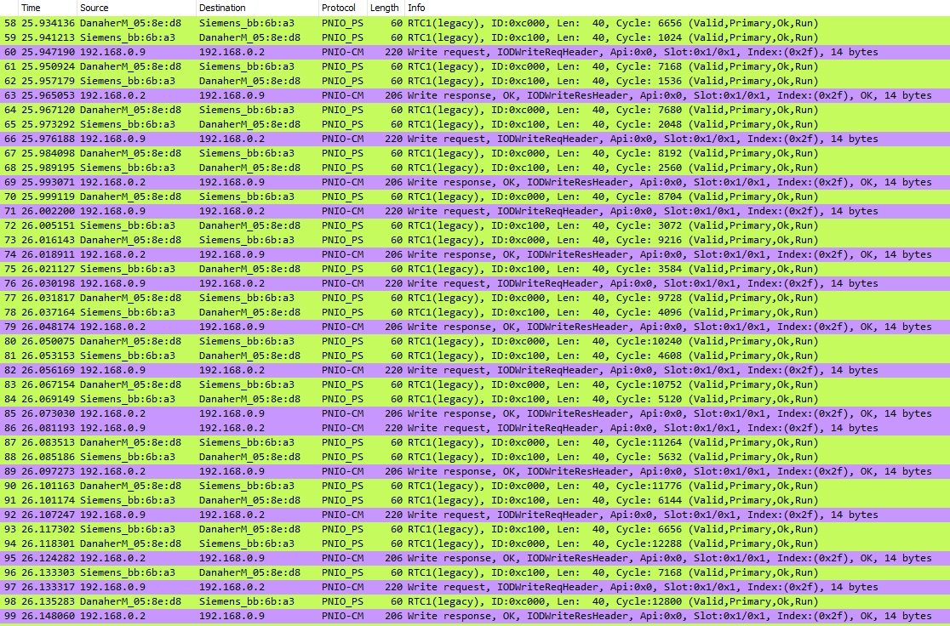
Profinet PNU Read/Write (SDO)
“Read request” and “Write request” are packets containing the PNU read and write commands from the PLC. The “response” is the response from the slave device.

Slide 26
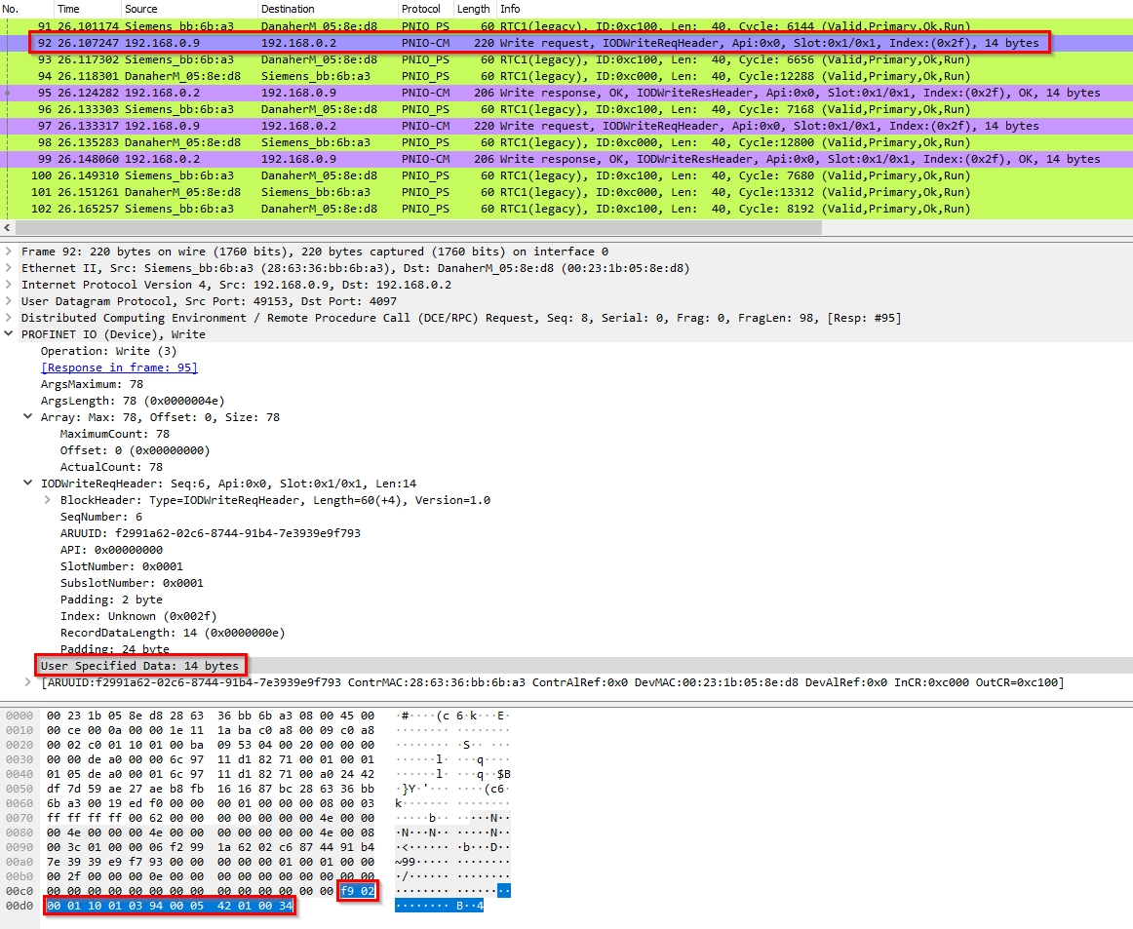
Profinet PNU Read/Write (SDO)
Example of a Write request from the PLC: writing to PNU 916 to define the data for Telegram 400

Slide 27

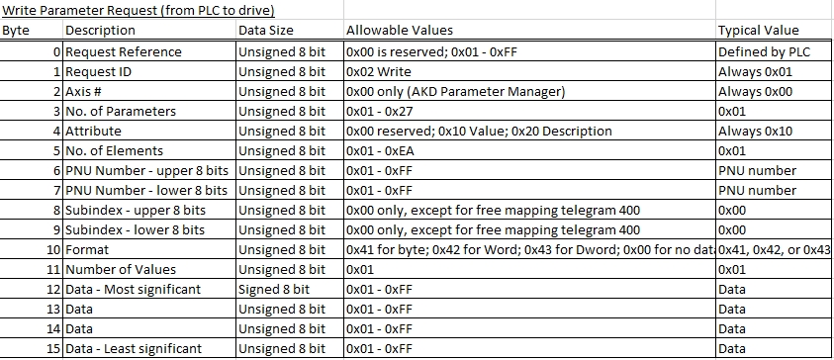
Profinet PNU Read/Write (SDO)
Example of a Write request from the PLC: writing to PNU 916 to define the data for Telegram 400

Slide 28
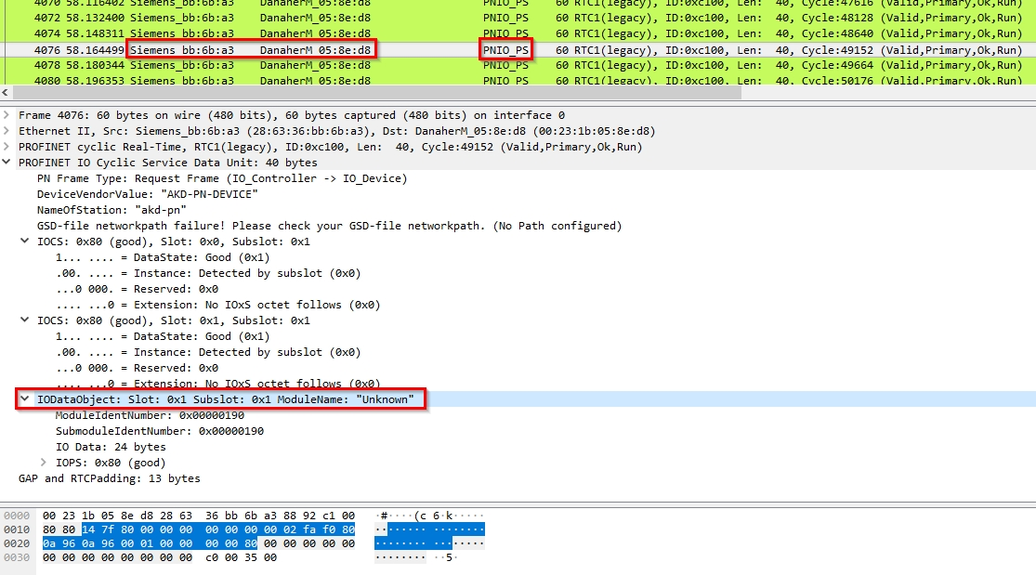
Profinet Telegram
The Profinet PNIO_PS capture contains the telegram data sent from the PLC to the AKD drive. IODataObject Slot 1 Subslot 1 is the telegram data.

Slide 29

Profinet Telegram
This example shows the data for Telegram 400 as defined in the AKD Profinet sample project.
STW1 (Control Word) = 0x147F – enabled and start motion
SATZANW = 0x8000 – use MDI motion profile settings
STW2 = 0x0000
MDI_TARPOS = 0x00000000 – moving to absolute target position of zero
MDI_TARPOS (lower word)
MDI_VELOCITY = 0x02FAF080 – move speed
MDI_VELOCITY (lower word)
MDI_ACC = 0x0A96
MDI_DEC = 0x0A96
MDI_MOD = 0x0001 – absolute move type
HOME_DIST = 0x0000
HOME_MODE = 0x0000
The next 80 means that the data is good.

Slide 30


