Slide 1
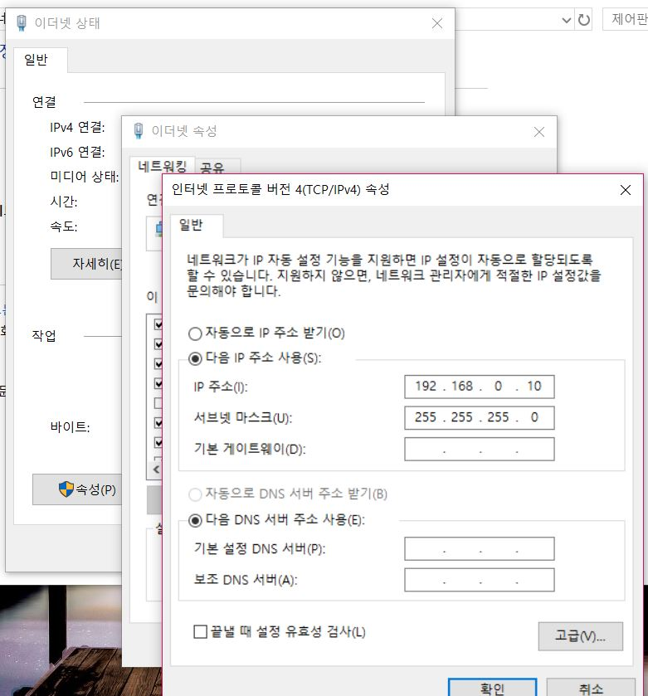
Ethernet status
Ethernet property
General
Use the following IP address
Obtain an IP address automatically
IP address
Subnet mask
Default gateway

Slide 2
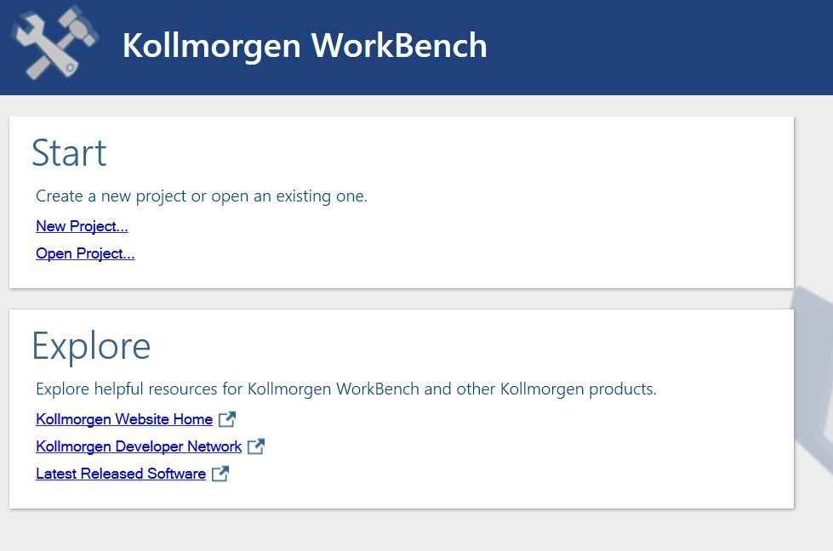
Click

Slide 3
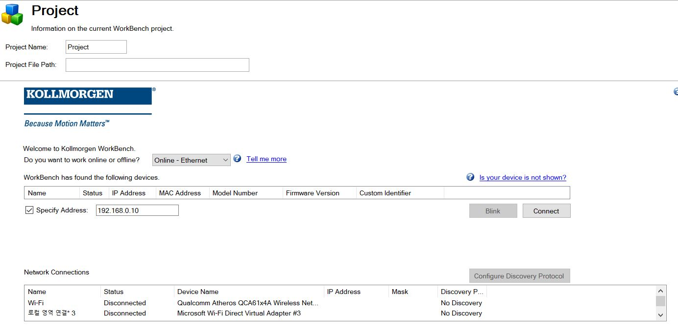
Driver IP address

Slide 4
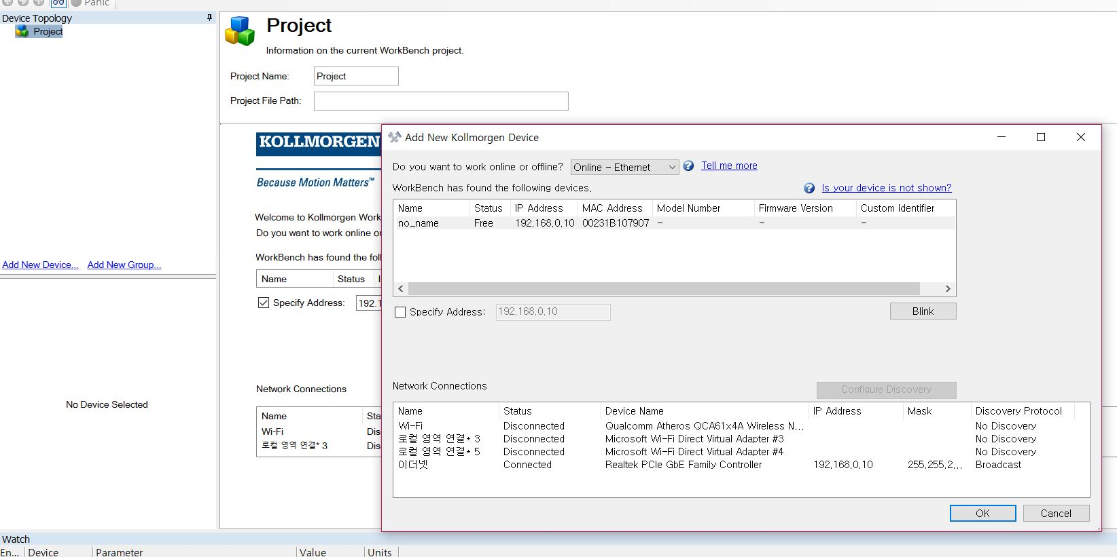
click
Driver IP address
Only Ethernet is Broadcast.
All adapter is no discovery.

