Slide 1
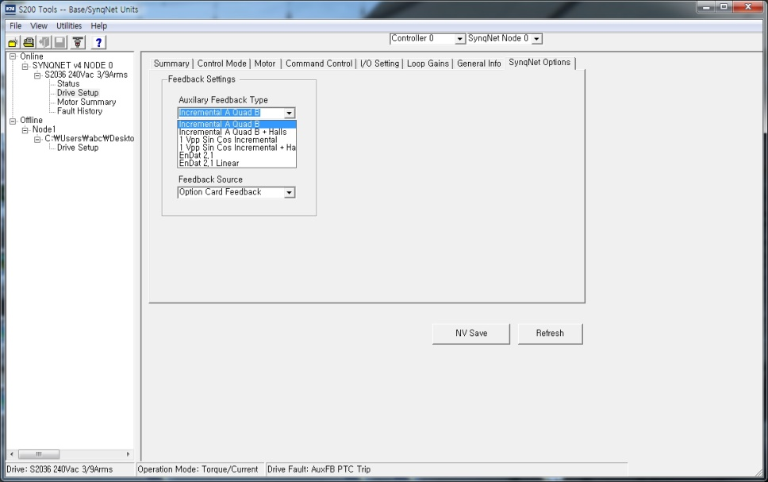
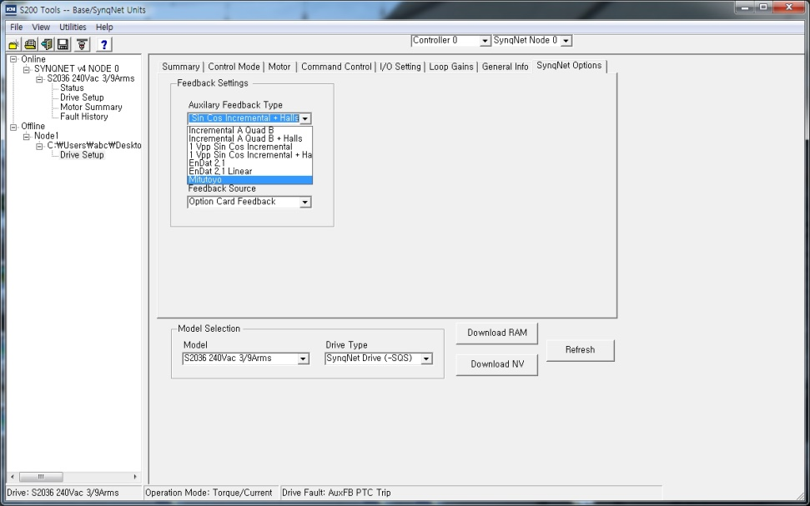
S200 4.0G SynqNet Drive Map Parameter File
Kollmorgen_S200.dm
Aux_FB_Type : Mitutoyo 0x38
Online
Mitutoyo is missing in Aux_FB_Type
Offline
Aux_FB_Type has Mitutoyo

Slide 2
Select Mitutoyo and click the Download button
ConfigGet using the sqDriveConfig utility and confirm that AUX_FB_TYPE has been changed to 0x38

