Slide 1
Resolving Servo Feedback Choices

Slide 2
Objective
The differences between absolute and incremental devices
The differences between analog and digital devices
Typical applications for various devices
How to choose the best feedback device for your specific application
How the devices affect system performance

Slide 3
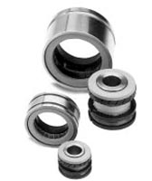
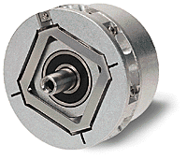
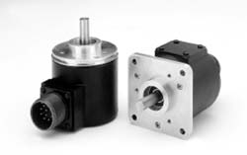
Feedback Types

Slide 4
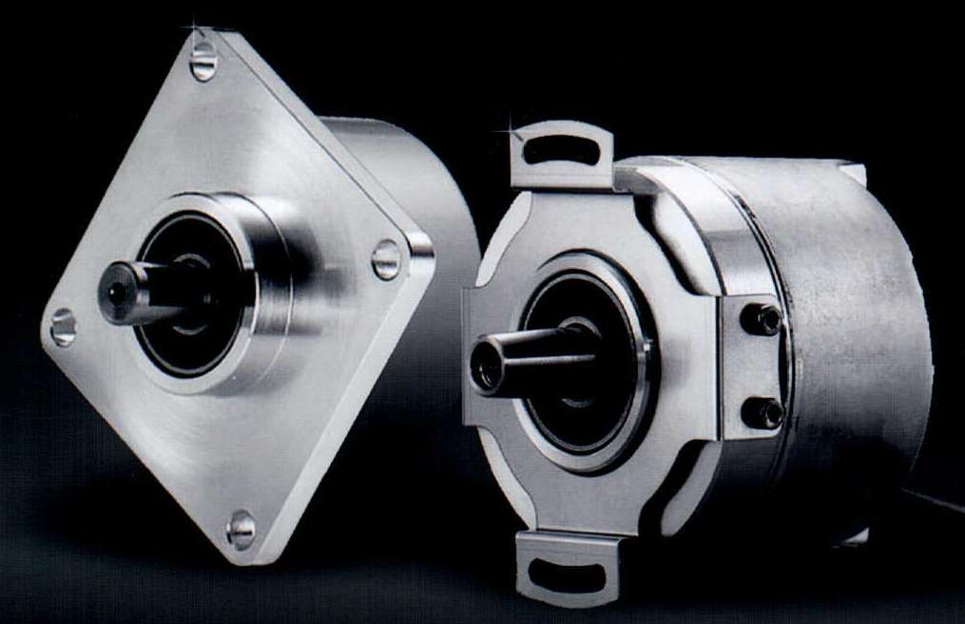
Sine Encoders
Digital Feedback Device
Sine, Cosine, Index and Complementary Signals
Incremental Signals 1 Vp-p
Provide the Best Feedback Resolution and Accuracy
Plug and Play Feature
Single-turn and Multi-turn Absolute

Slide 5
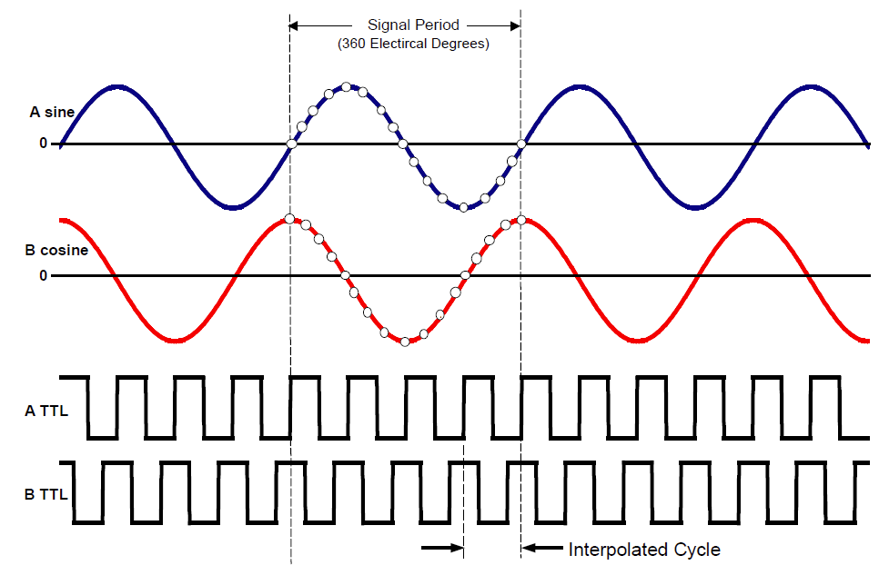
Signal Interpolation
The Sine encoder’s 1Vp-p analog sin/cos signals are digitally increased by the process of Interpolation. Interpolation is a mathematical process for multiplying a single sine wave. In the AKD this interpolation factor is 16 bits, and in the AKD2G 32 bits.
Example of 4 bits (2⁴) Signal Interpolation

Slide 6
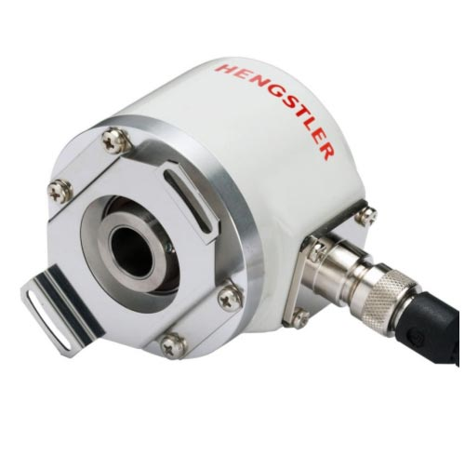
BiSS Sine Encoder
Plug and Play Feedback
10 bits (2¹⁰) - 2048 Line Counts
27 bits resolution (AKD) 134,217,728
32 bits resolution (AKD2G) 4,294,967,294
12 bit (2¹²) Multi-turn
4096 revs
RS-485 Data
Operated Temperature Rated -20 to 115º C
Accuracy ~ +/-1.33 arc-min
Maximum cable Length 50 meters

Slide 7
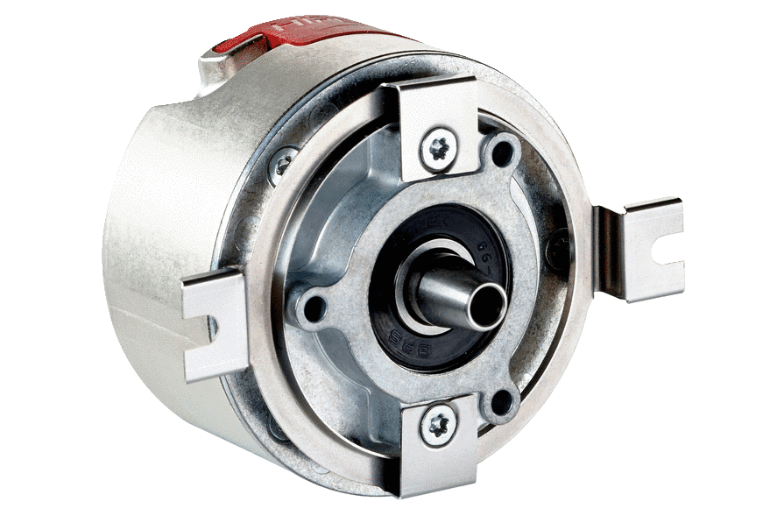
HIPERFACE Sine Encoder
Plug and Play Feedback
7 bit (2⁷) - 128 Line Count
23 bits resolution (AKD) 8,388,606
31 bits resolution (AKD2G) 2,147,483,648
12 bit (2¹²) Multi-turn
4096 revs
RS-485 Data
Operated Temperature Rated -20 to 115º C
Accuracy ~ +/-1.33 arc-min
Maximum cable length 50 meters

Slide 8
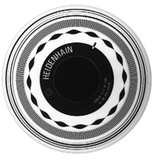
Endat Sine Encoder
Plug and Play Feedback
Line Counts 512, 2048 standard
27 bits resolution (AKD) 134,217,728
32 bits resolution (AKD2G) 4,294,967,294
12 bit (2¹²) Multi-turn
4096 revs
RS-485 Data
Operated Temperature Rated -20 to 115º C
Accuracy ~ +/- 0.33 arc-min
Maximum cable Length 50 meters

Slide 9
Absolute Sine Encoder Advantages
Plug and Play Feature
Single or Multi-turn Absolute Feedback Options
High Resolution Due to Digital Signal Interpolation
Higher Position Accuracy
Higher Position and Velocity loop Gains
Best Servo System Bandwidth
Low velocity Ripple
Up to 32 bits resolution (AKD2G) 4,294,967,294 counts
+/-1.33 arc-min Accuracy
Maximum cable Length 50 meters

Slide 10
Digital Only Feedbacks
Digital Feedback Device
No Interpolation with Digital only Feedback
Plug and Play Feedback
RS-485 Serial Data Only
Absolute Position Devices
Single Turn and Multi-turn (4096 revs)
No Interpolation with Digital only Feedbacks
Single Hybrid Cable Option

Slide 11
HIPERFACE DSL “Digital Only”
Plug and Play Feature
Motor & Tuning Information
17 Bits Resolution AKD, AKD2G 131,072 counts
RS-485
Single-turn and Multi-turn (4096 revs) Absolute
Operating Temperature -40° C to 115° C
Accuracy ~ +/- 1.33 arc-min
Single Hybrid Cable Max. length 25 meters

Slide 12
Endat 2.2 “Digital Only”
Plug and Play Feature
Motor & Tuning Information
19 Bits Resolution AKD, AKD2G 524,288 counts
RS-485
Multi-turn (4096 revs) Absolute is Available
Single-turn Absolute * Upon Request
Operating Temperature -40° C to 115° C
Accuracy ~ +/- 2 arc-min
Single Hybrid Cable Max. length 25 meters

Slide 13
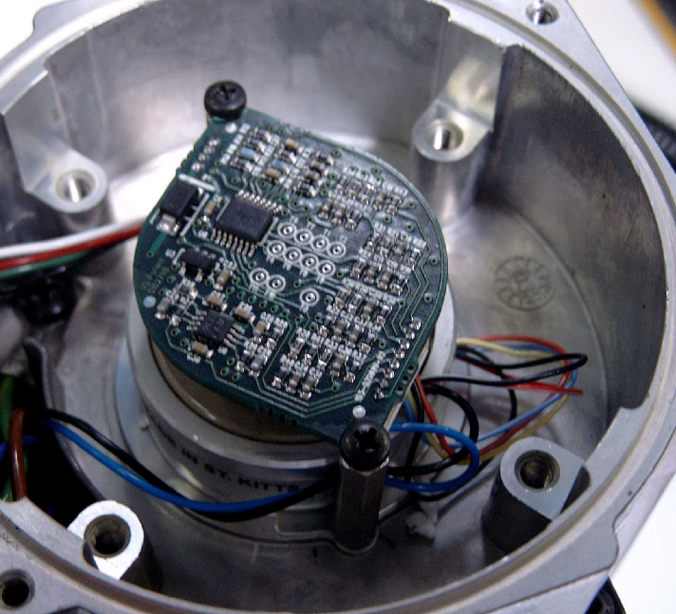
Smart Feedback Device SFD
Digital Feedback Device
Plug and Play Feature
Single-turn Absolute Device
Reduced Wire Count
Gen 3 – 2 wires “CA”
Gen 2 – 4 wires “C”
Resolution
AKD2G & AKD: 2²⁴ Bits
16,777,216 (0.0097 arc-sec)
Operating Temperatures -40 to 120° C
Accuracy
Accuracy +/-9 - +/- 16 arc-min
Single Hybrid Cable Max. length 25 meters
Sensor Accuracy Size 10 sensor +/- 16 arc-min Size 15 sensor +/- 9 arc-min Size 21 sensor +/- 9 arc-min

Slide 14
Digital Only Feedback Advantages
Single or Multi-turn Absolute Feedback Options
Plug and Play Feature
Good Feedback Resolution
Good Servo System Response (Bandwidth)
+/-1.33 arc-min of Accuracy
Single Hybrid Cable Max. length 25 meters

Slide 15
Resolver
Analog Feedback Device
Sine & Cosine Sinusoidal Signals
Absolute Single-turn (Single Speed)
No Plug and Play Feature
RDRES = 2²⁴ (AKD/AKD2G) 16,777,216 counts
Accuracy ~ +/- 15 arc-min
Operating Temperature -55 to 155° C
Maximum cable Length 100 meters

Slide 16
Resolver Advantages
Very Robust “Bullet Proof”
Absolute Single-turn (Single Speed)
Good Resolution 2²⁴ (AKD/AKD2G) 16,777,216”
Great Operating Temperature -55 °C to 155 °C
Maximum cable Length 100 meters

Slide 17
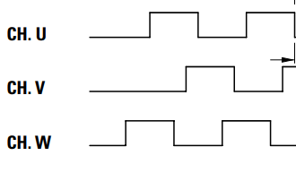
Commutating Encoder
Digital Feedback Device
No Plug and Play Feature
Incremental with Commutation Tracks (TTL)
Channel Outputs
A, B, /A, /B
Index or Marker (once per rev)
Hall Tracks for Commutation
Common Resolutions 1024 and 2048
Temp Rated 0 to 120 º C
Accuracy ~ +/- 2.5 arc-min
Maximum cable Length 25 meters
x4

Slide 18
Commutating Encoder Advantages
Accuracy ~ +/- 2.5 arc-Min
Low Resolution Causes Bad Velocity Regulation Due Quantization Error
No Absolute Position Information
Require Hall Feedback for Motor Commutation
Not Very Robust
x4

Slide 19
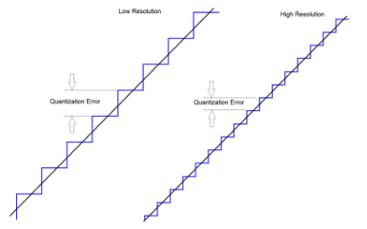
Quantization Error
Notes:
These plots show how the numerator and denominator of the biquad combine to create the total biquad response.

Slide 20
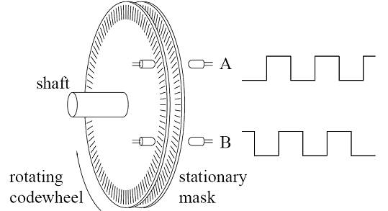
Feedback Comparison?
Sometimes poor feedback devices are selected because it is assumed the servo drive can always “fix it” with filtering
It is often forgotten that system stability is extremely sensitive to delays, almost all digital filters cause delays!
It is important to understand the effects of the feedback, from quantization errors from low resolution.
Notes:
These plots show how the numerator and denominator of the biquad combine to create the total biquad response.

Slide 21
Test Setup
To compare feedback devices, a system was constructed with same size motor and same size load, spinning a motor at 60RPM with no filtering occurring in the feedback path.
Each AKD system is tuned to the same system bandwidth.
Feedbacks to analyzed:
Endat (or Sin/Cos equivalent) 512 Lines/rev
“Total Resolution 33,554,432”counts
Commutating Encoder (4096 count/rev)
Notes:
These plots show how the numerator and denominator of the biquad combine to create the total biquad response.

Slide 22
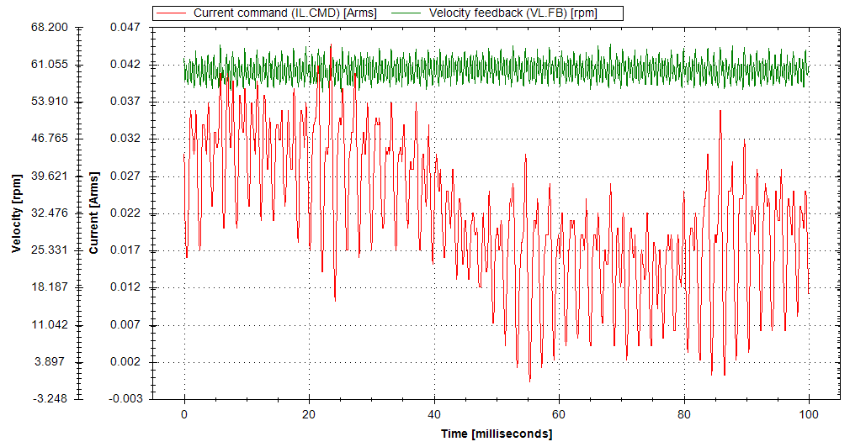
Endat Feedback Results, 512 Lines/rev
Notes:
These plots show how the numerator and denominator of the biquad combine to create the total biquad response.

Slide 23
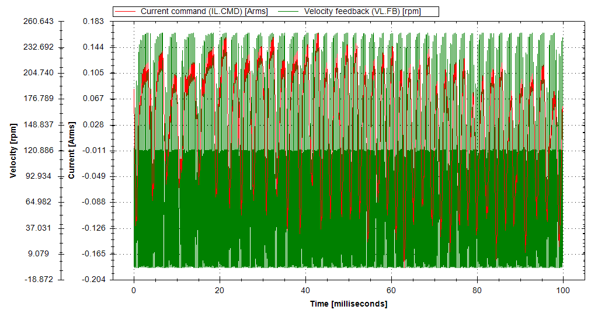
Commutating Encoder (4096 counts/rev)
All Incremental feedback devices suffer from quantization noise, with it becoming a larger effect as resolution decreases.
Example of 4096 count/rev encoder:
Notes:
These plots show how the numerator and denominator of the biquad combine to create the total biquad response.

Slide 24
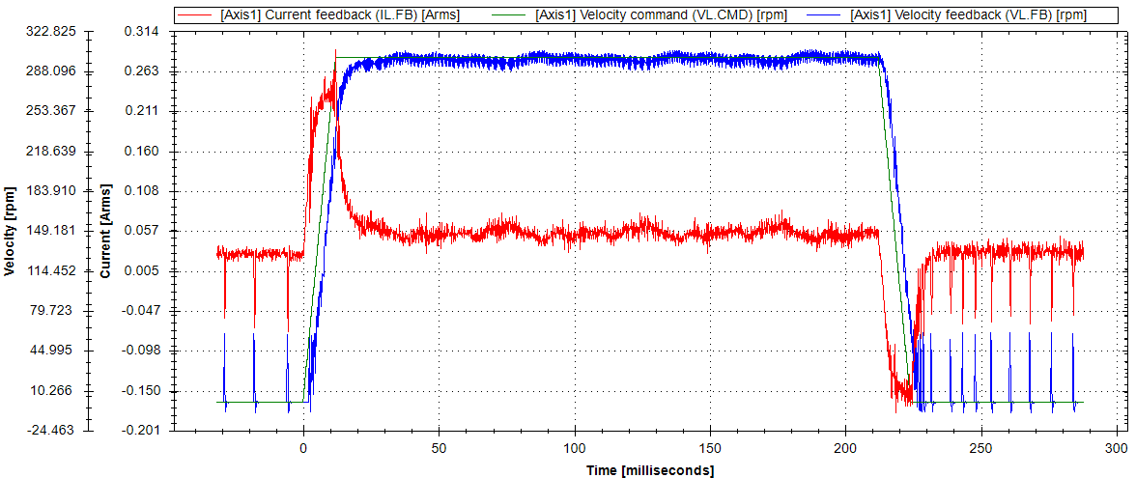
Commutating Encoder (4096 counts/rev)
300 RPM Step Move

Slide 25
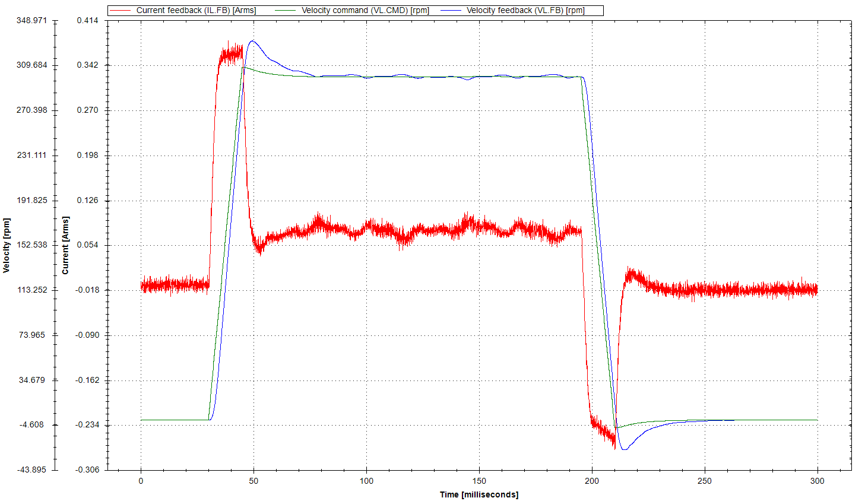
Endat Feedback (512 Lines/rev) 25 bits
300 RPM Step Move

Slide 26
How Low Resolution Affects Performance
Low resolution feedbacks require adding Low-Pass filters in the feedback path clean up velocity information, causing delays in the system.
Low speed instability due to limited velocity measurement capability
The motor’s operating current is higher due to velocity ripple caused by feedback quantization errors.
Servo position and velocity loop gains require being set to lower values, so the system is stable due to feedback quantization error
Lowering servo gains reduce system response (Bandwidth)

Slide 27
How to Choose a Feedback Device
Precision Accuracy – Sine Cosine or Digital Only Encoders
Simplify Homing - Sine Cosine or Digital Only Encoders, Multi-turn and Single-turn Absolute Position Option
High bandwidth and rejection disturbance and precision accuracy – Sine Encoder.
Cost Sensitivity but high velocity requirements – SFD
Harsh environments with vibration and high temperatures - Resolver
Long Cable Lengths – Resolver or Sine Encoder
Single Cable Requirement: SFD3, Hyperface DSL, or Endat 2.2. This is limited due to cable length of 25 Meters.

Slide 28
Typical Applications for Various Feedbacks
Waterjet & Plasma Cutting Machine
Index Application – Large Inertia
High Resolution Sine Encoders
Smart Feedback Device (Cost Effective Solution)
High Resolution Sine Encoders
Digital Only Encoders
Printing Application
Punch Press with High Vibration and Forge Applications in Harsh Environments
High Resolution Sine Encoders
Digital Only Encoders
Resolver
Smart Feedback Device

Slide 29
Kenny Hampton
Level 2 Application Engineer
Kollmorgen

