Slide 1
TwinCAT3 to AKD EtherCAT Setup and Demonstration using ESI Default Settings and Mapping and Default EtherCAT Scaling

Slide 2
TwinCAT3 to AKD EtherCAT Setup and Demonstration using ESI Default Settings and Mapping and Default EtherCAT Scaling

Slide 3
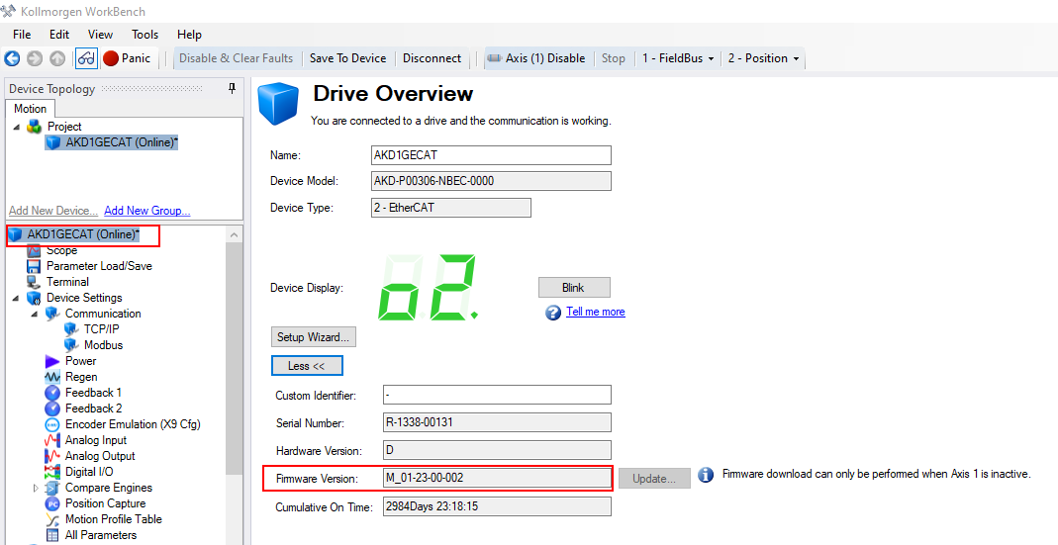
STEP 1: Identify the AKD Drive Firmware
Identify what version of firmware is resident in the AKD drive using Workbench.
Navigate to the Drive Overview screen and click More to see the Firmware Version.
The firmware used in this presentation is 1-23-00-002.

Slide 4
STEP 2: Download the firmware zip file
Download the firmware zip file that matches the resident drive firmware from the Kollmorgen website and and extract all.

Slide 5
STEP 3: Locate the ESI file from the zip file.
Setting up TwinCAT3 for operation with the AKD drive is almost identical to TwinCAT2. Some of the terminology is different and the xml file goes in a different location but the general process is the same.
There are 2 XML files for the AKD EtherCAT drive: One for TwinCAT2 and one for TwinCAT3. At some point in time the naming conventions for these XML files changed to make the naming more intuitive.
Original Naming Convention
TwinCAT3 XML file: “AKD EtherCAT Device Description.xml”
TwinCAT2 XML file: “AKD_TwinCAT.xml”
New Naming Convention
TwinCAT3 XML file: “AKD.xml”
TwinCAT2 XML file: “AKD_TwinCAT2.xml”.

Slide 6
STEP 3: Locate the ESI file from the zip file.
This procedure will use latest firmware and XML file at the time of this presentation’s creation and will assume the new naming convention and use of TwinCAT3.
Locate the XML file named “AKD.xml” in the firmware zip file in the fieldbus folder.

Slide 7
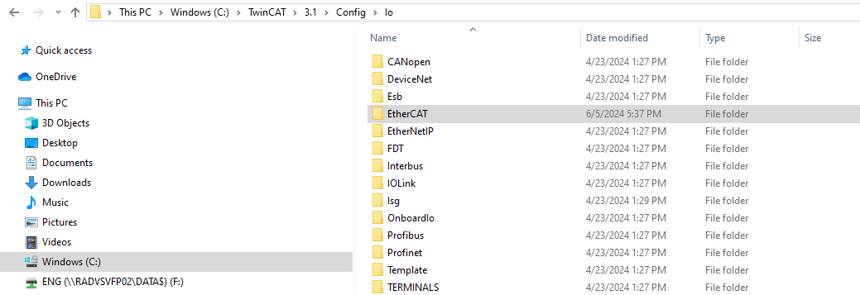
STEP 4: Copy the ESI file and paste to TwinCAT folder
Copy the “AKD.XML” and paste into the TwinCAT folder.
After pasting and navigating to the EtherCAT folder:

Slide 8
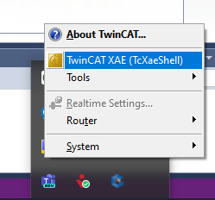
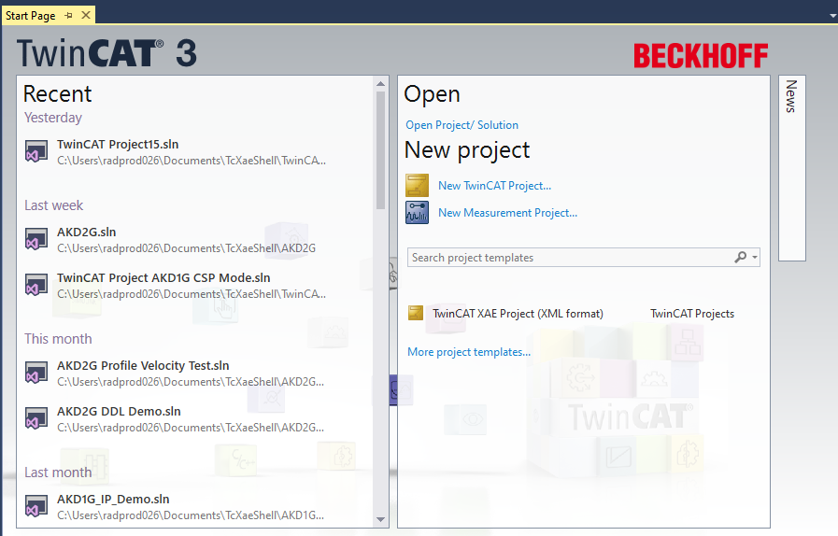
STEP 5: Open TwinCAT3
Click on the TwinCAT icon in the system tray and click “TwinCAT XAE” to start the TwinCAT software. The Start Page opens. Click on the Start Page under New project->New TwinCAT project…

Slide 9
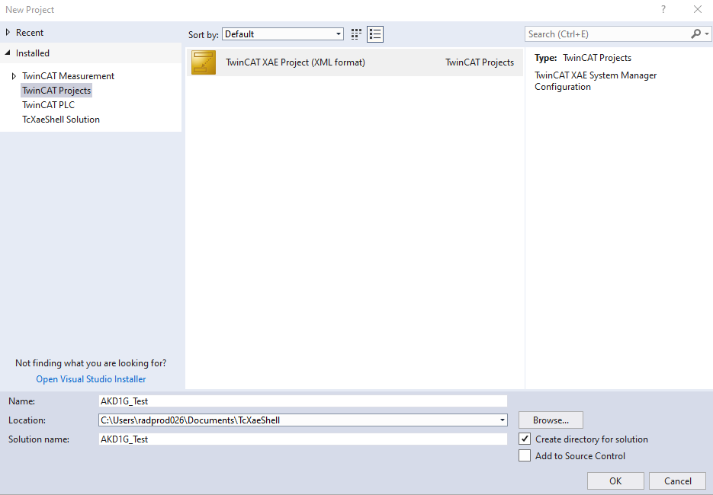
STEP 6: Name the New Project
Give the new project a name and click OK.
Note the TwinCAT project type is “TwinCAT XAE Project (XML format)”

Slide 10
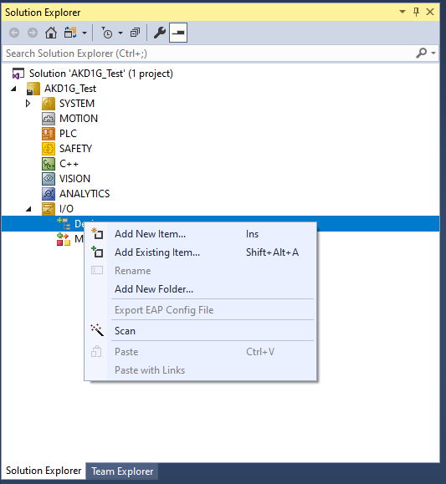
STEP 7: Scan For Devices
Expand I/O in the Solution Explore and then Right-Click Devices and click Scan to scan for the Ethernet Adapter that will be used for EtherCAT communications.

Slide 11
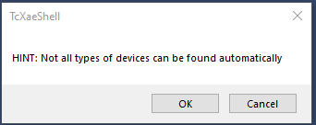
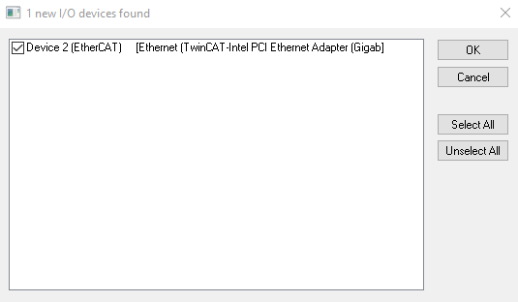
STEP 7: Scan For Devices
Click OK on HINT dialogue
Select the appropriate Ethernet Adapter and click OK.

Slide 12
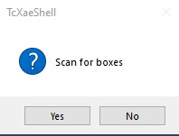
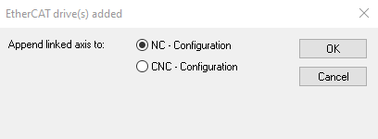
STEP 8: Scan For Boxes
Note “Boxes” is an alias for, in this case, AKD drives connected to the Ethernet Adapter for TwinCAT3.
Click Yes to scan for boxes (AKD drives)
Click Yes to link the AKD drive to a NC axis.

Slide 13
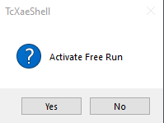
STEP 9: Click No to Activating Free Run Mode
Further setup will be conducted prior to going to Run Mode so click No to not Activate Free Run.

Slide 14
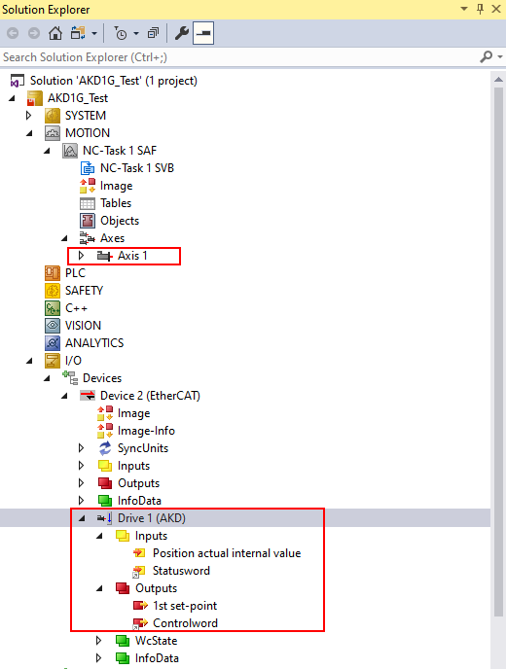
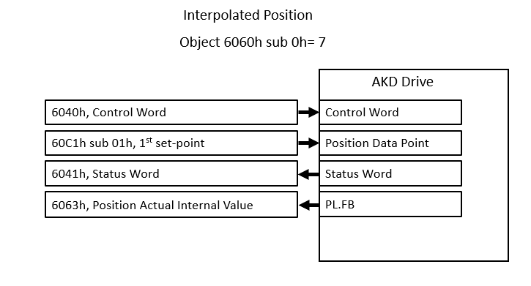
STEP 10: AKD is added to Devices
Solution Explorer shows Axis 1 under NC-Task 1 SAF and Drive 1(AKD) is under Devices->Device 2(EtherCAT) with the default Inputs and Outputs generated from the ESI file.
Common PDO data is shown on the right which matches the default PDOs from the ESI file.

Slide 15
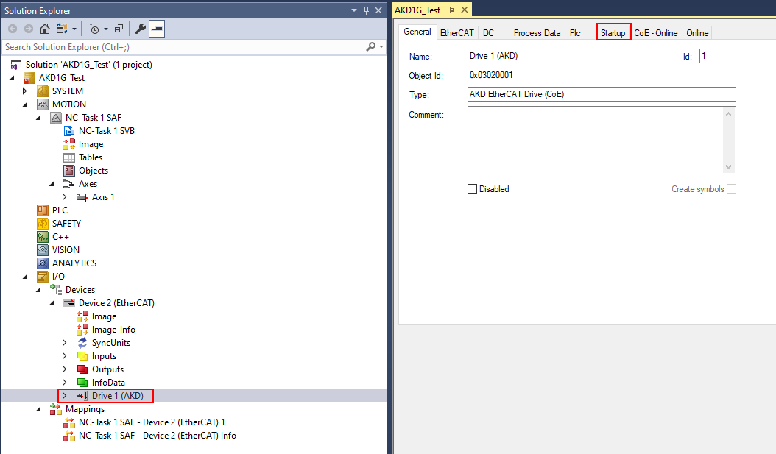
STEP 11: Startup tab on Drive 1 (AKD)
Double-click on Drive 1(AKD) in the Solution Explorer.
A range of tabs are displayed on the right (General, EtherCAT, etc.). Click on the Startup tab.

Slide 16
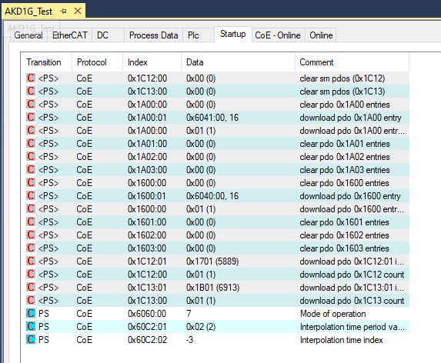
STEP 11: Startup tab on Drive 1 (AKD)
The default Startup Tab from the ESI file provides the startup list of CoE SDO writes.
This includes:
SDOs to map the PDOs.
Mode of Operation ( default is 7=Interpolated Position )
AKD Drive EtherCAT Sample Period ( FBUS.SAMPLEPERIOD ) where default is 2000 us or 2 msec

Slide 17
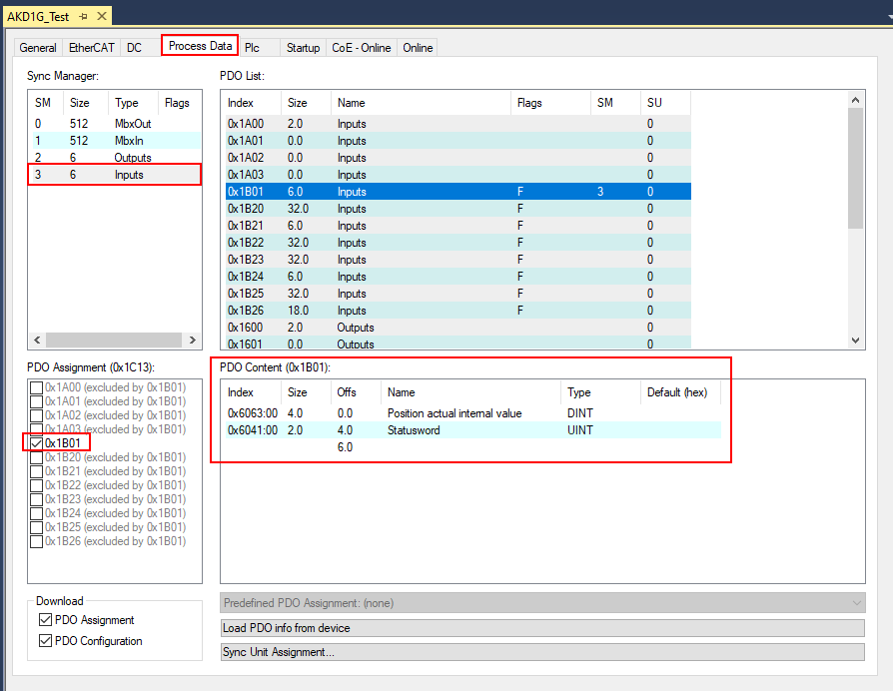
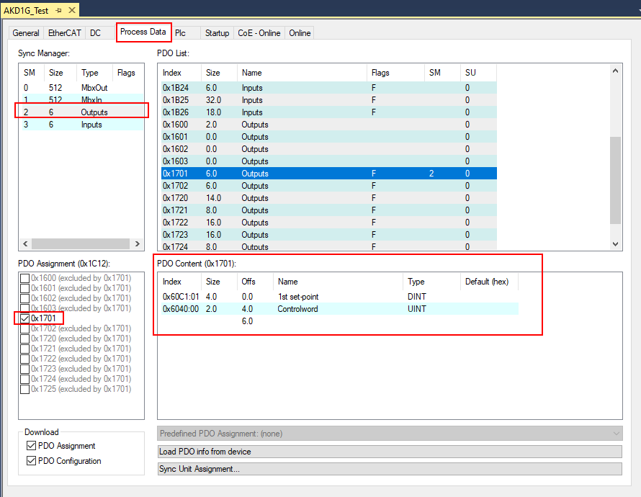
STEP 12: Process Data ( PDO mapping )
Still under Drive 1 (AKD) click on the Process Data tab.
The Process Data tab shows the current (default) PDO mapping for Inputs and Outputs.
0x1701 is the Fixed RxPDO (Output) and its PDO contents are 60C1 sub01 and 6040 as shown below.
0x1B01 is the Fixed TxPDO (Input) and its PDO contents are objects 6063 and 6041 as shown below.

Slide 18
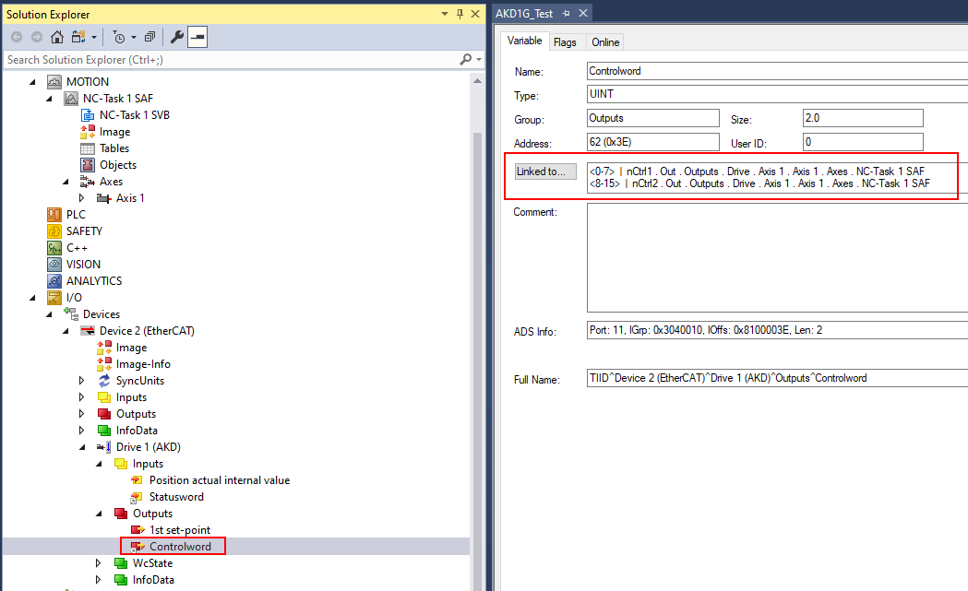
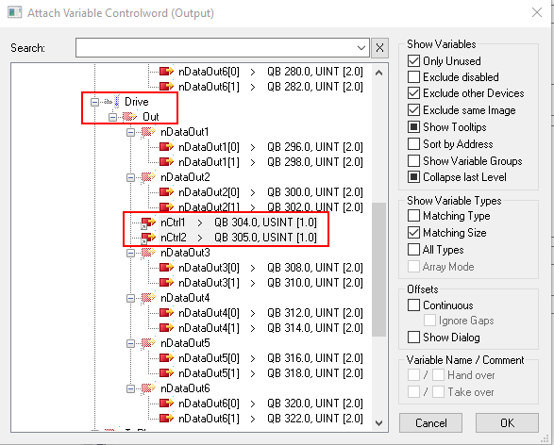
STEP 13: Linking PDOs to NC Task-Axis 1 (Controlword)
Using the ESI file for FW 1-23-00-002 (used in this presentation), the Statusword and Controlword are pre-linked to the NC Task-Axis 1.
Outputs->Controlword
On the left below shows the Link for Controlword (object 6040h)
When clicking the “Linked To” button the right window appears showing the link to the NC Task-Axis 1.

Slide 19
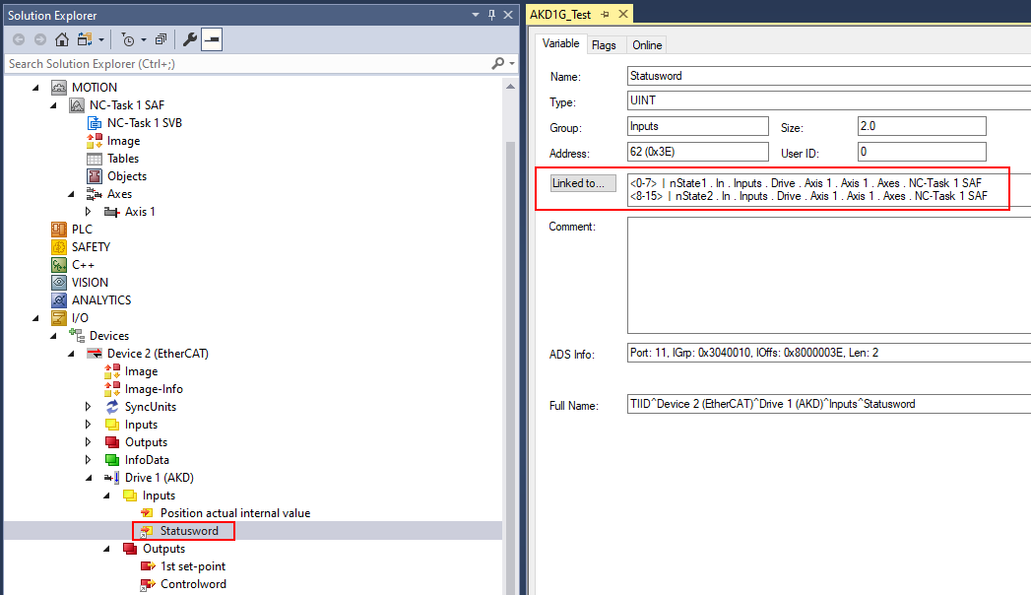
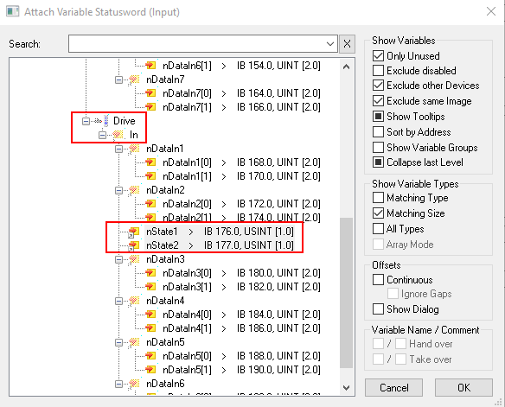
STEP 13: Linking PDOs to NC Task-Axis 1 (Statusword)
Using the ESI file for FW 1-23-00-002 (used in this presentation), the Statusword and Controlword are pre-linked to the NC Task-Axis 1.
Inputs->Statusword
On the left below shows the Link for Statusword (Object 6041)
When clicking the “Linked To” button the right window appears showing the link to the NC Task-Axis 1.

Slide 20
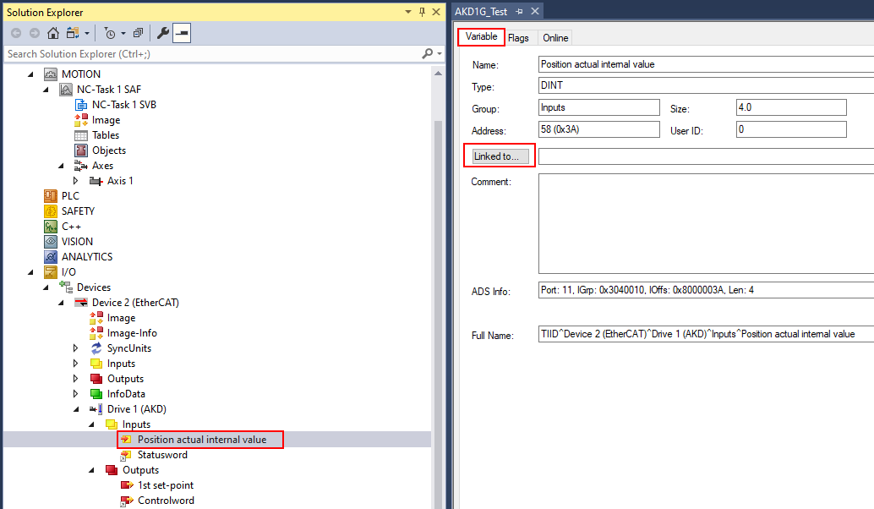
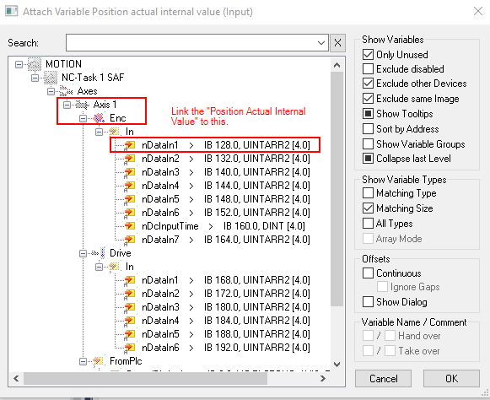
STEP 13: Linking PDOs to NC Task-Axis 1 (Position Actual Internal Value)
Under the Solution Explorer Drive 1(AKD) click on “Position actual internal value” under Inputs as shown on the left below.
In the middle screenshot the “Variable” tab the “Linked To” field is empty (no link) for Position actual internal value (object 6063),
On click of the “Linked To” button the right window “Attach Variable Position actual value (Input)” appears showing the appropriate link to the NC Task-Axis 1.
Link the “Position actual internal value” to the NC Task-Axis 1 as shown and click OK.

Slide 21
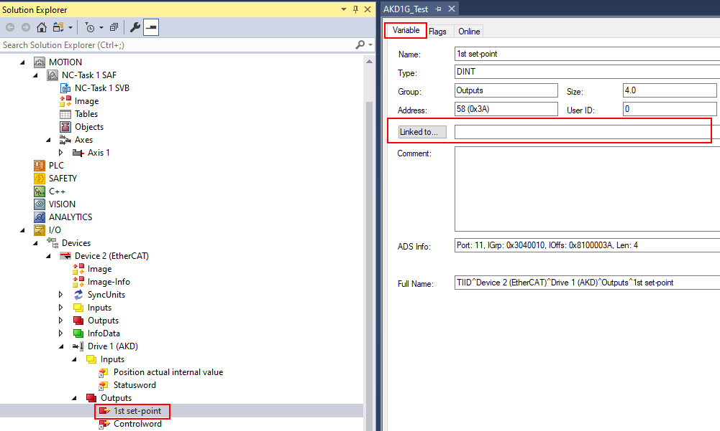
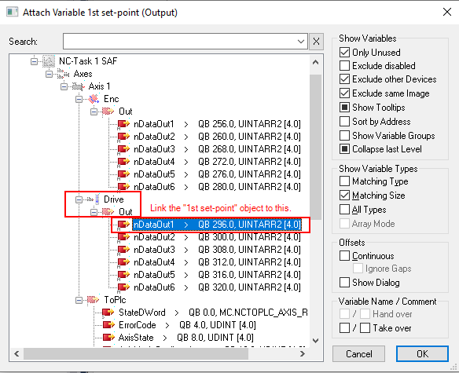
STEP 13: Linking PDOs to NC Task-Axis 1 (1st set-point)
Under the Solution Explorer Drive 1(AKD) click on 1st set-point under Outputs as shown on the left below.
In the middle screenshot the “Variable” tab the “Linked To” field is empty (no link) for 1st set-point (Object 60C1h sub 1)
On click of the the “Linked To” button the right window “Attach Variable 1st set-point (Output)” appears showing the appropriate link to the NC Task-Axis 1.
Link the 1st set-point (output) to the NC Task-Axis 1 as shown and click OK.

Slide 22
STEP 14: Disable monitoring for Bench Test
Under NC-Task- Axis 1 click on the Parameter tab as shown and expand the Monitoring group.

Slide 23
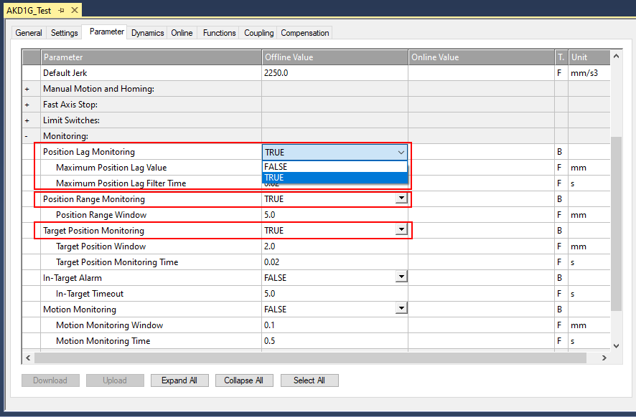
STEP 14: Disable monitoring for Bench Test
Change the 3 positioning monitoring settings from the default “TRUE” to “FALSE”.
Note: Disabling positioning monitoring assumes a bench test. In a real application these settings are the
programmer’s responsibility.

Slide 24
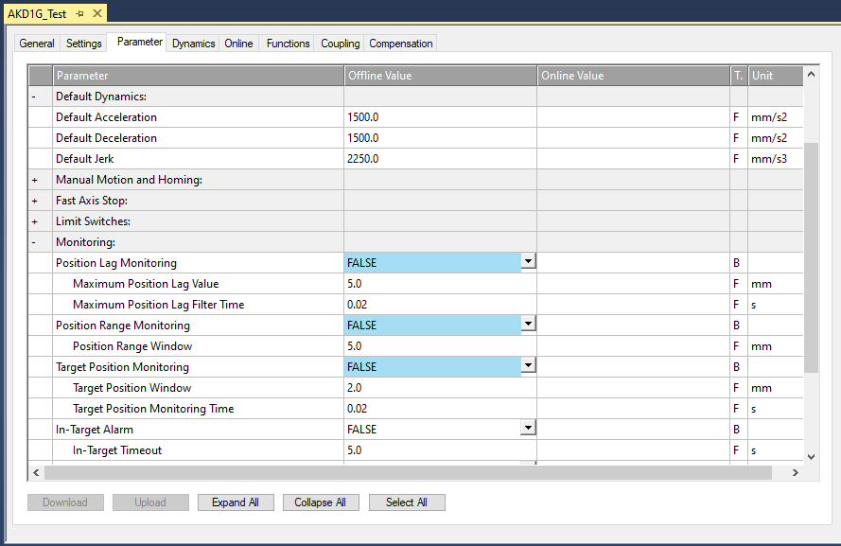
STEP 14: Disable monitoring for Bench Test
Click the Save icon in the toolbar to save these settings.

Slide 25
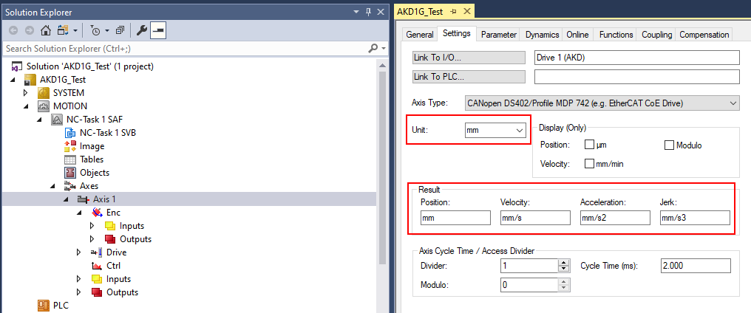
STEP 15: Set Axis Units and Scaling
Under NC-Task->Axes->Axis 1 click the “Settings” tab. The default Unit is “mm” which will be used.

Slide 26
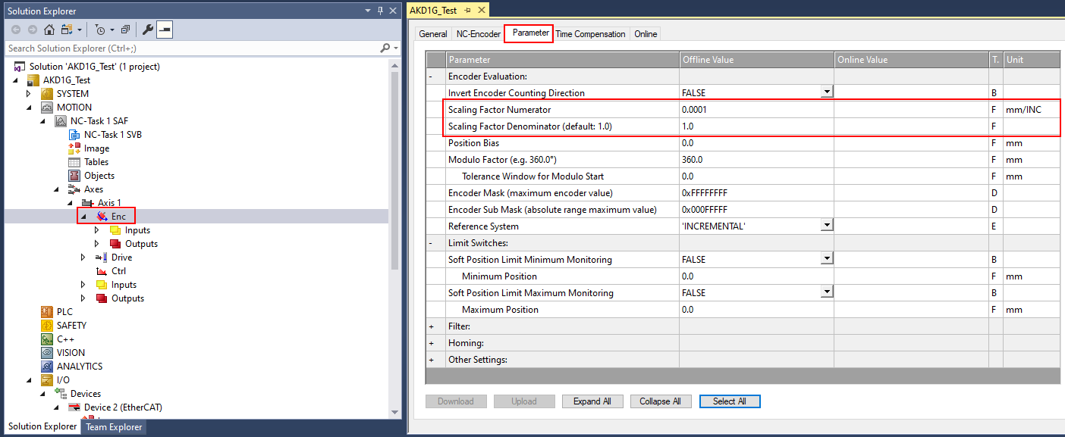
STEP 15: Set Axis Units and Scaling
Under NC-Task->Axes->Axis 1->Enc click the “Parameter” tab. The Scaling Factor Numerator and Denominator are shown with default values.

Slide 27
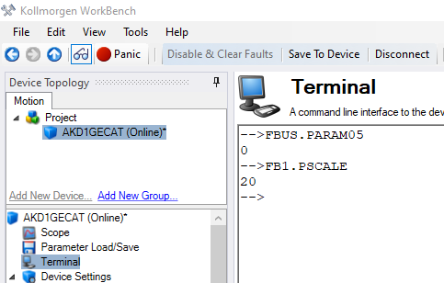
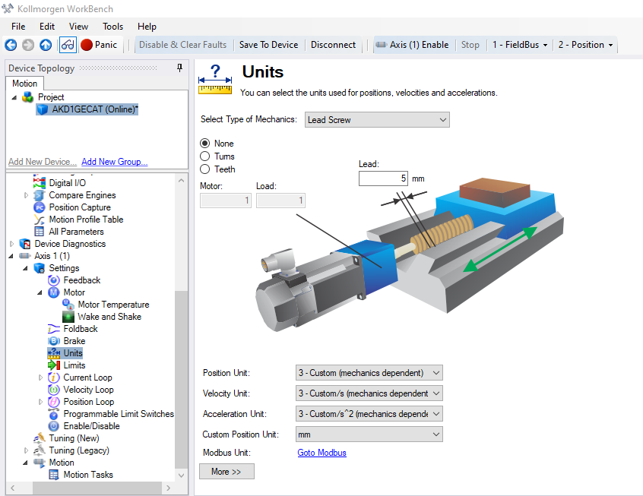
STEP 15: Set Axis Units and Scaling
In Workbench when FBUS.PARAM05=0 and FB1.PSCALE=20 (both default values) EtherCAT scaling for IP Mode is 2^20 or 1048576 counts per rev of motor.
In this example Workbench Units is set for a 5mm per rev ballscrew with position, velocity, and acceleration units set to 3-Custom (mechanics dependent) and units in mm.
Keep in mind Workbench Units are for values displayed or set in Workbench and not related to EtherCAT scaling (this example is setup so Workbench and EtherCAT units agree).

Slide 28
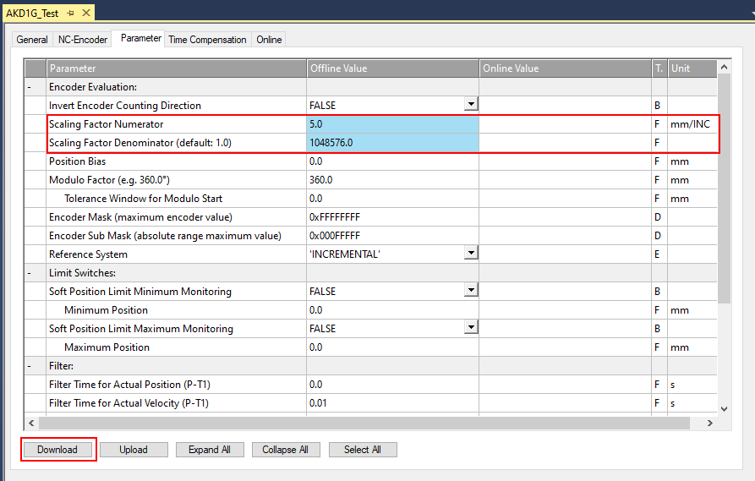
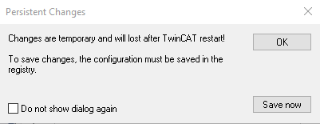
STEP 15: Set Axis Units and Scaling
Returning to TwinCAT3 and setting the Scaling Factor Numerator and Denominator.
The Scaling Factor Numerator is in mm for TwinCAT3 which will be set to 5 mm (the lead of the ballscrew in this example).
The Scaling Factor Denominator will be set to 1048576 (equivalent to the number of counts per rev in EtherCAT units for the AKD drive.
Click the Download button and then Save now button on the Persistent Changes pop-up window.

Slide 29
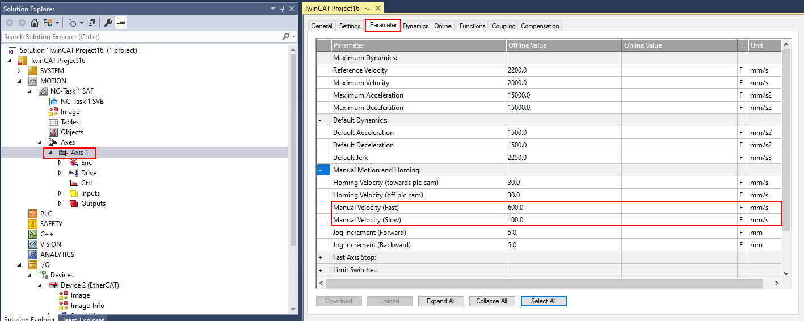
STEP 16: Set Manual Velocity for Jogging From Console
Return to the NC-Task->Axes->Axis 1->Parameter tab to adjust the Manual Velocity settings. These are correlated to with the +/- (slow) and ++/-- (fast) buttons on the Console in TwinCAT3.

Slide 30
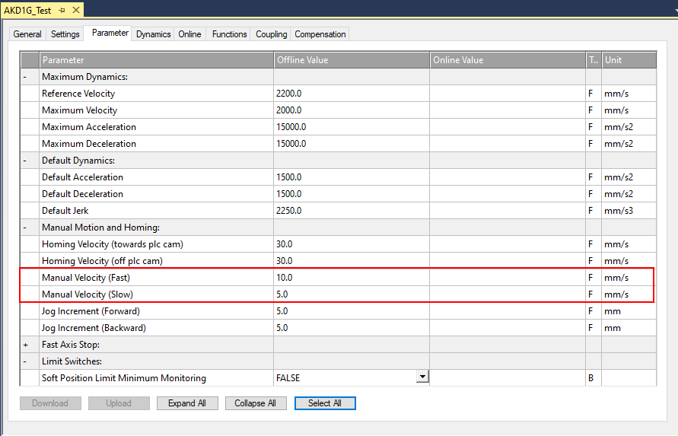
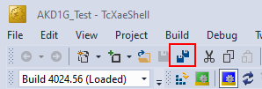
STEP 16: Set Manual Velocity for Jogging From Console
These settings are application dependent. For this demonstration they are changed to 10 mm/s (fast) and 5 mm/s (slow). Save settings.

Slide 31
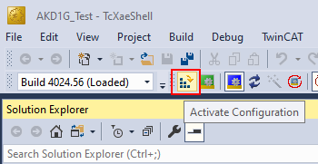
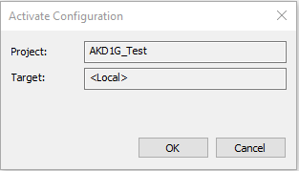
STEP 17: Generate Mappings, Activate Config, Restart in Run Mode
Right-click “Mappings” in the Solution Explorer and click “Generate Mappings”.
Activate Configuration in the toolbar and click ok.

Slide 32
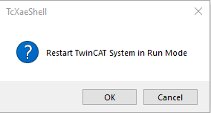
STEP 17: Generate Mappings, Activate Config, Restart in Run Mode
Click OK to start run mode.
The TwinCAT3 status bar shows “Ready” on the left and the icon on the right increments numerical indicating the TwinCAT3 project is running.

Slide 33
STEP 18: Enabling and Generating Motion from the Console
First note in Workbench the axis is inactive and SW (software enable) is off but the drive is ready to be enabled.
PL.CMD (position command) and PL.FB (position feedback) are added to the Watch window in Workbench for convenience

Slide 34
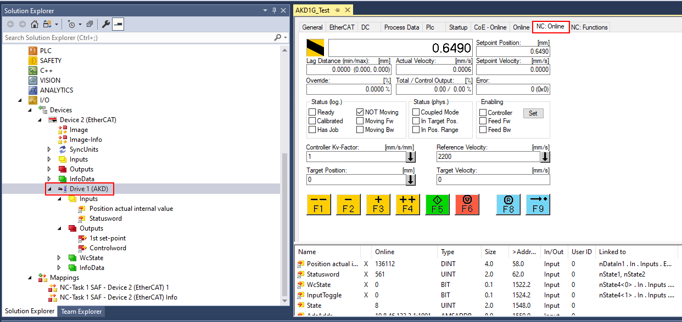
STEP 18: Enabling and Generating Motion from the Console
Navigate to the Console in TwinCAT3 by clicking on the AKD drive in the Solution Explorer and then click on the NC-Online tab.
Note: The console also be accessed by navigating to NC-Task->Axes->Axis 1-> NC-Online tab.

Slide 35
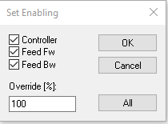
STEP 18: Enabling and Generating Motion from the Console
Click the “Set” button under Enabling in the Console.
On the Set Enabling pop-up window click the “All” button or check all 3 boxes and set the override to an appropriate value.
The Workbench status bar indicates the axis is enabled.

Slide 36
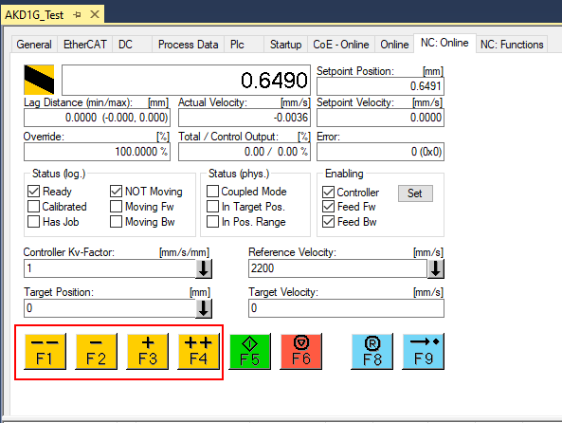
STEP 18: Enabling and Generating Motion from the Console
Jogging from the Console.
The +/- buttons Jog Increment Forward/Reverse.
The ++/-- buttons Jog at the Manual Velocity Fast/Slow as set by step 16.
These rates can be changed under NC-Task->Axes->Axis 1->Parameter Tab.

Slide 37
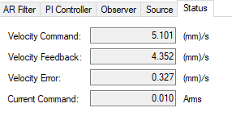
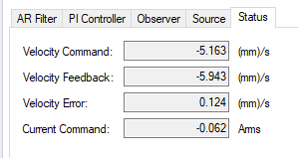
STEP 18: Enabling and Generating Motion from the Console
With F3 (+) held down and monitoring in Workbench under Axis 1->Velocity Loop->Status tab the axis jogs at the velocity of +5 mm/s
With F2 (-) held down and monitoring in Workbench under Axis 1->Velocity Loop->Status tab the axis jogs at the velocity of -5 mm/s

Slide 38
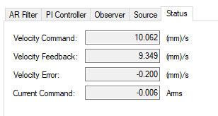
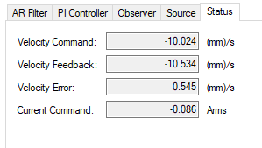
STEP 18: Enabling and Generating Motion from the Console
With F4 (++) held down and monitoring in Workbench under Axis 1->Velocity Loop->Status tab the axis jogs at the velocity of +10 mm/s
With F1 (--) held down and monitoring in Workbench under Axis 1->Velocity Loop->Status tab the axis jogs at the velocity of -10 mm/s

Slide 39
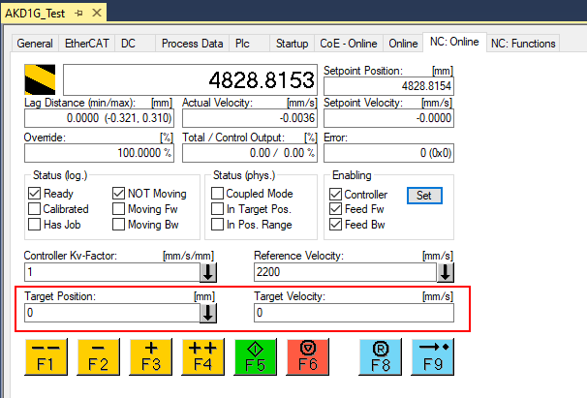
STEP 18: Enabling and Generating Motion from the Console
Making A Positional Move via the Console.
The Target Position and Target Velocity for the move are entered here.

Slide 40
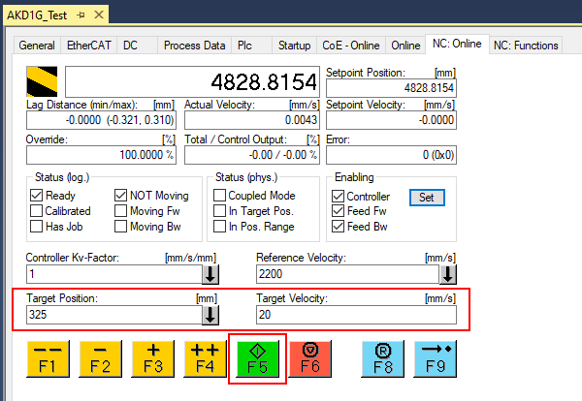
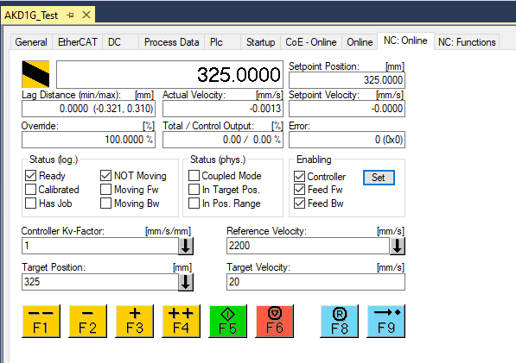
STEP 18: Enabling and Generating Motion from the Console
For this demonstration, a target velocity of 20 mm/s and a target position of 325 mm are entered.
Keep in mind the accel/decel and maximum speed limits settings in the NC-Task->Axes->Axis 1 are used. The maximum speed limits will prevent the motion command from executing. Adjust if necessary.
Press the F5 (green) button to start the move and watch the position actual in the Console.
When move is complete the position actual shows 325.0000 mm in both the Console and in Workbench.

Slide 41
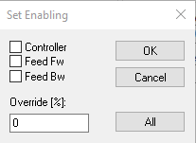
STEP 18: Enabling and Generating Motion from the Console
Disable the axis by clicking the Set button under Enabling in the Console.
Uncheck all 3 checkboxes and set the Override % to zero and click OK.
Note: The drive will also disable if only the Controller checkbox is unchecked.
From the Workbench Status bar the axis is now disabled.

