Slide 1
TwinCAT3 to AKD EtherCAT Setup and Demonstration using CSP (Cyclic Synchronous Position) mode of operation and DS402 scaling

Slide 2
TwinCAT3 to AKD EtherCAT Setup and Demonstration using CSP (Cyclic Synchronous) mode of operation and DS402 scaling

Slide 3
STEP 1: First Complete The Initial Startup Procedure
This presentation and procedure assumes the presentation and procedure of initial setup from defaults using the ESI file and in Interpolated Position mode of operation has been conducted to completion prior to this procedure.

Slide 4
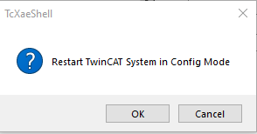
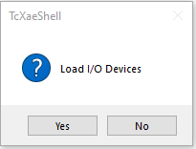
STEP 2: Change TwinCAT3 to Config mode.
Click on the Restart TwinCAT (Config Mode)
Click OK(Config Mode) to exit Run Mode and enter Config Mode.
Click Yes on Load I/O Devices.

Slide 5
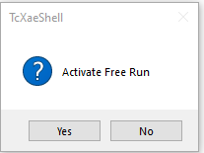
STEP 2: Change TwinCAT3 to Config mode.
Click No on Activate Free Run to proceed to Config mode.
From the Status bar in TwinCAT3 it shows Ready and the icon on the right shows Config mode.

Slide 6
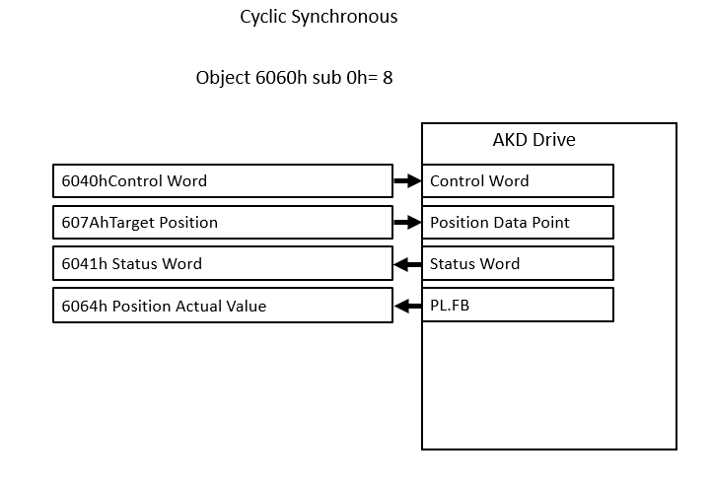
STEP 3: Overview of CSP Mode
Cyclic Synchronous Position mode uses a different object for the position command. Where Interpolated Position mode uses 60C1h sub 1 (1st set-point), Cyclic Synchronous Position mode uses 607Ah Target Position.
Cyclic Synchronous Position mode is set by 6060h sub 0h (modes of operation)=8.

Slide 7
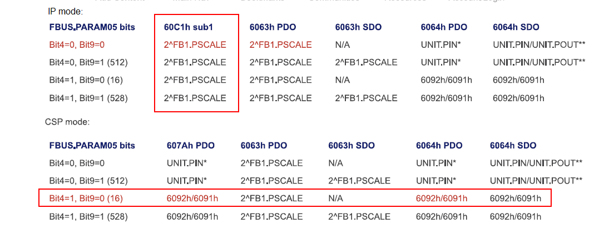
STEP 3: Overview of CSP Mode
Per the chart below from the AKD EtherCAT scaling app note, in IP mode the command object 60C1h sub 1 1st set-point PDO data can only be scaled using 2^FB1.PSCALE.
Compare to CSP mode where DS402 scaling can be used for both target position (607Ah) AND position actual 6063h or 6064h so both the command and the feedback can be scaled for DS402 (real-world) scaling a distinct benefit.

Slide 8
STEP 3: Overview of CSP Mode
Object 6063h, position actual internal value, was used for position actual from the ESI file in IP mode.
In this demonstration object 6064, position actual value, will be used for CSP mode.

Slide 9
STEP 4: Setting DS402 Scaling
The DS402 scaling can be setup either in Workbench terminal or via SDOs in the Startup tab of the AKD drive in TwinCAT3.
This presentation will use Workbench terminal.
To switch to DS402 FBUS.PARAM05 is set to 16.

Slide 10
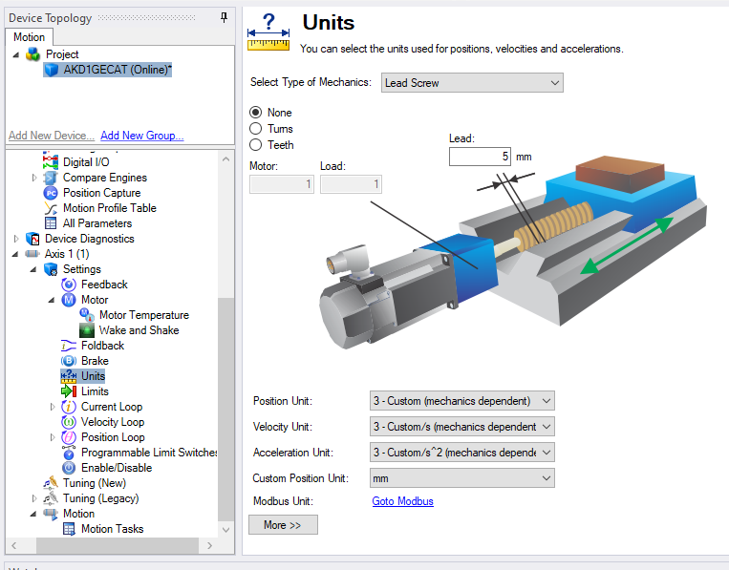
STEP 4: Setting DS402 Scaling
Recall from the default presentation Workbench Units is set for a 5 mm ballscrew actuator.

Slide 11
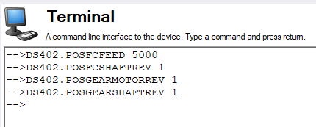
STEP 4: Setting DS402 Scaling
The DS402 scaling is set where 5000 represents x.xxx mm where 5000 = 5.000 mm or ( mm x 1000).

Slide 12
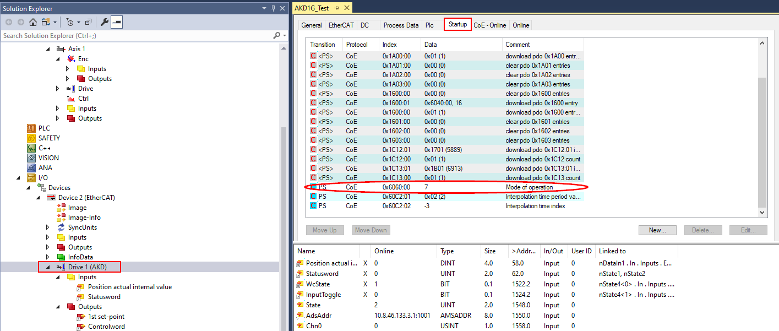
STEP 5: Change mode of operation in Startup tab.
In the Solution Explorer in TwinCAT3 click on the AKD drive and click on the Startup tab.
From the default of the ESI file the mode of operation in the Startup tab is 7-Interpolated Position mode.

Slide 13
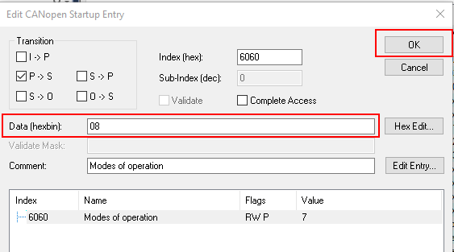
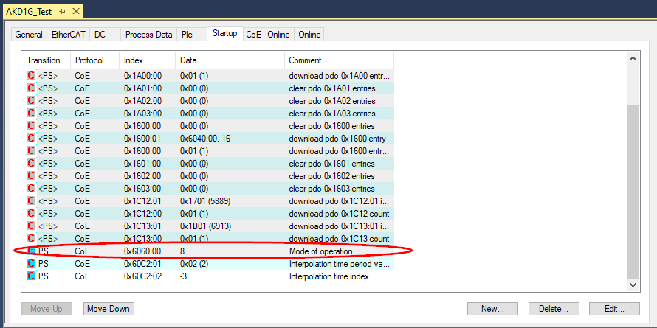
STEP 5: Change mode of operation in Startup tab.
Edit object 6060h Mode of Operation and change to 8-Cyclic Synchronous Position mode and click OK.

Slide 14
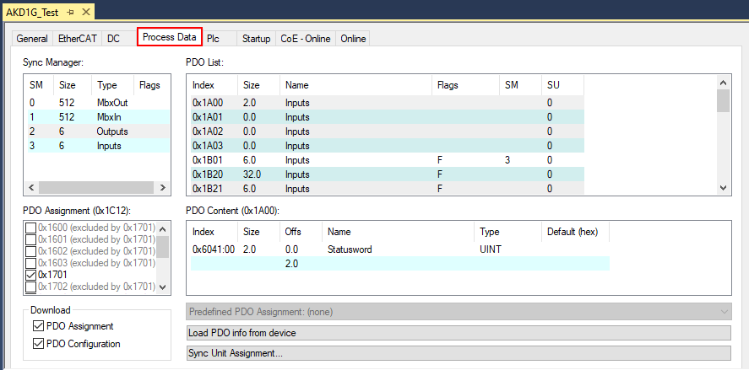
STEP 6: Change PDO mapping from default to flexible
From the Startup tab click the Process Data tab to the left.

Slide 15
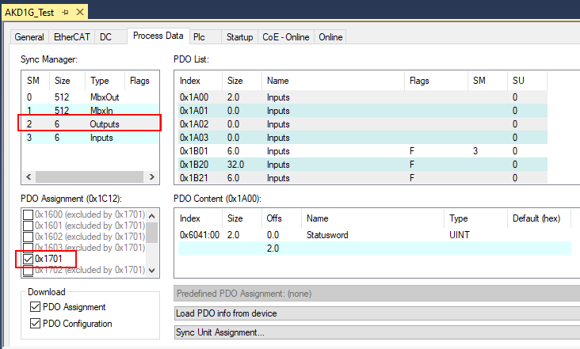
STEP 6: Change PDO mapping from default to flexible
Click on Outputs as shown below and uncheck the PDO Assignment 0x1701 (fixed output PDO mapping)

Slide 16
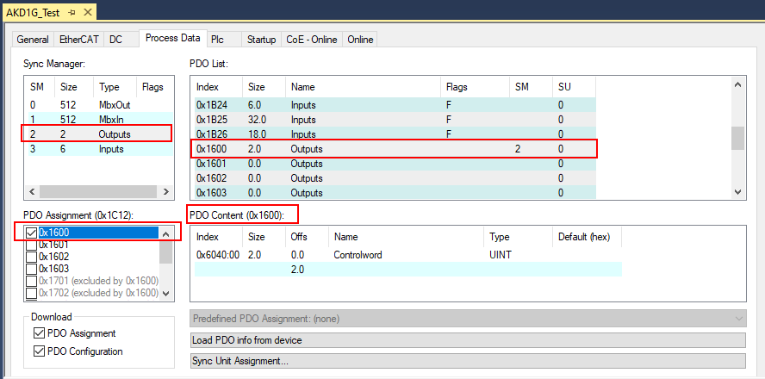
STEP 6: Change PDO mapping from default to flexible
With Outputs still selected check the checkbox beside 0x1600 under PDO assignment and select 0x1600 in the PDO List as shown.

Slide 17
STEP 6: Change PDO mapping from default to flexible
Do not make any changes to the first entry 6040 (control word) in the PDO content of 0x1600.
Right-click on the second line and select “Add New Item”.

Slide 18
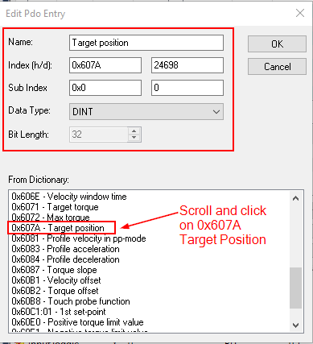
STEP 6: Change PDO mapping from default to flexible
Scroll and click on 0x607A in the Dictionary list and click OK.
The new PDO content for 0x1600 is shown.

Slide 19
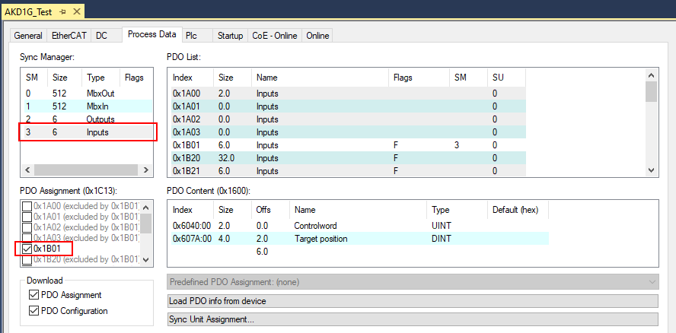
STEP 6: Change PDO mapping from default to flexible
Click on Inputs as shown below and uncheck the PDO Assignment 0x1B01 (fixed input PDO mapping)

Slide 20
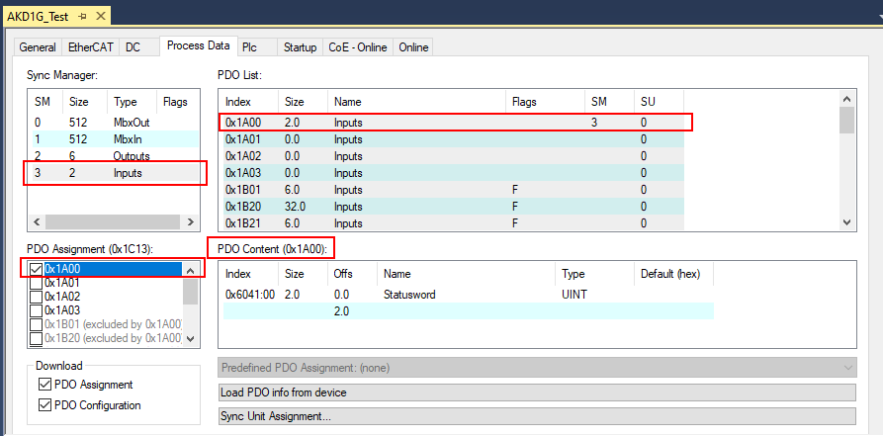
STEP 6: Change PDO mapping from default to flexible
With Inputs still selected check the checkbox beside 0x1A00 under PDO assignment and select 0x1A00 in the PDO List as shown.

Slide 21
STEP 6: Change PDO mapping from default to flexible
Do not make any changes to the first entry 6041 (status word) in the PDO content of 0x1A00.
Right-click on the second line and select “Add New Item”.

Slide 22
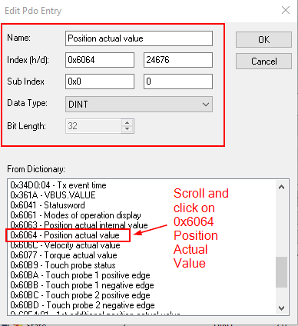
STEP 6: Change PDO mapping from default to flexible
Scroll and click on 0x6064 in the Dictionary list and click OK.
The new PDO content for 0x1A00 is shown.

Slide 23
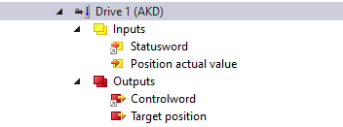
STEP 6: Change PDO mapping from default to flexible
The Inputs and Outputs under the AKD drive in the Solution Explorer now appears as modelled from the common PDO diagram for Cyclic Synchronous Position mode shown on the right.

Slide 24
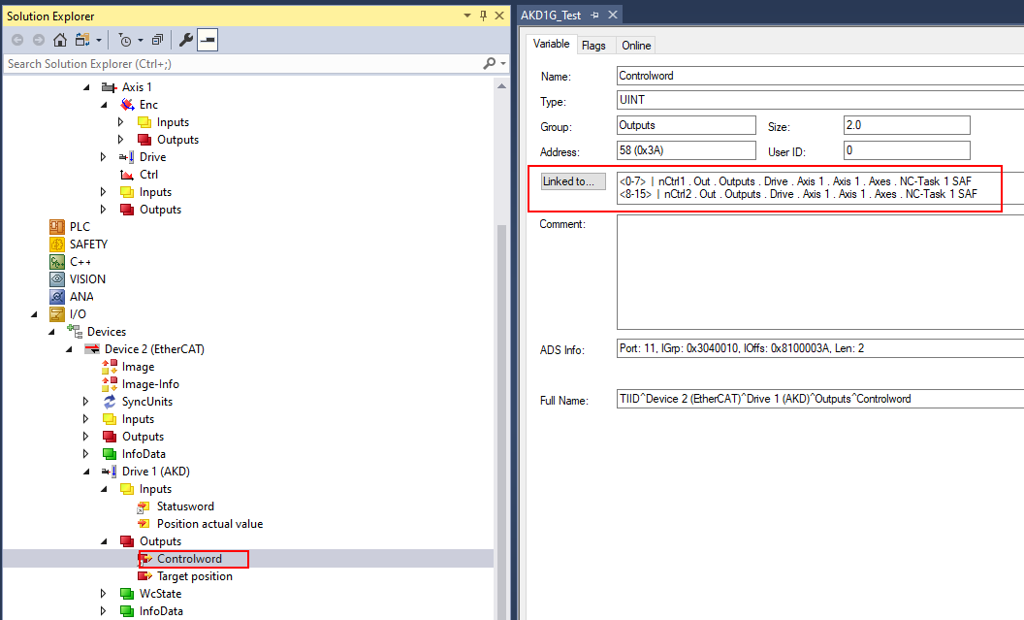
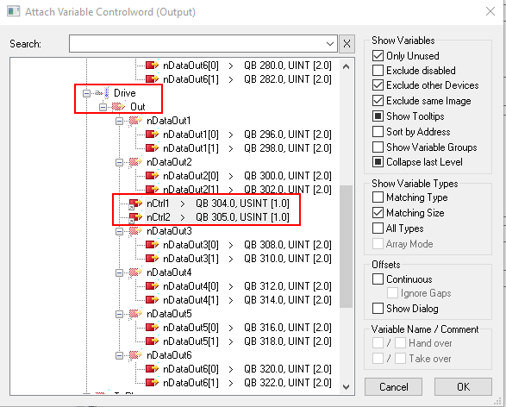
STEP 7: Linking PDOs to NC Task-Axis 1 (Controlword)
With the latest ESI file for FW X.XX the Statusword and Controlword are pre-linked to the NC Task-Axis 1.
Outputs->Controlword
On the left below shows the Link for Controlword (object 6040h)
When clicking the “Linked To” button the right window appears showing the link to the NC Task-Axis 1.

Slide 25
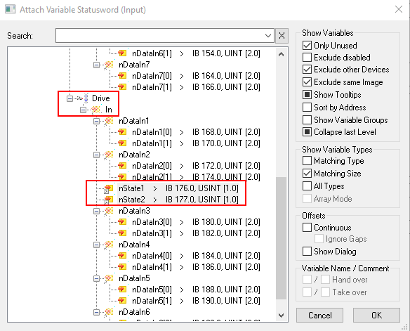
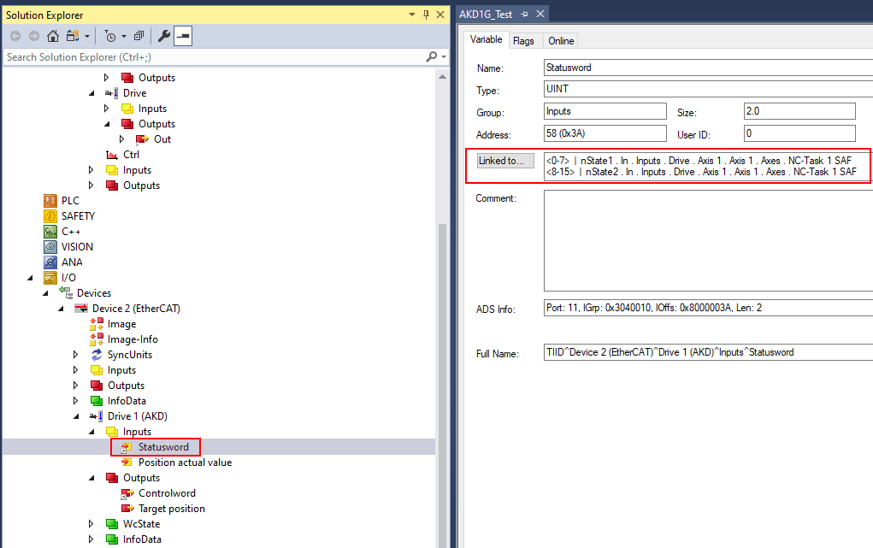
STEP 7: Linking PDOs to NC Task-Axis 1 (Statusword)
With the latest ESI file for FW X.XX the Statusword and Controlword are pre-linked to the NC Task-Axis 1.
Inputs->Statusword
On the left below shows the Link for Statusword (Object 6041)
When clicking the “Linked To” button the right window appears showing the link to the NC Task-Axis 1.

Slide 26
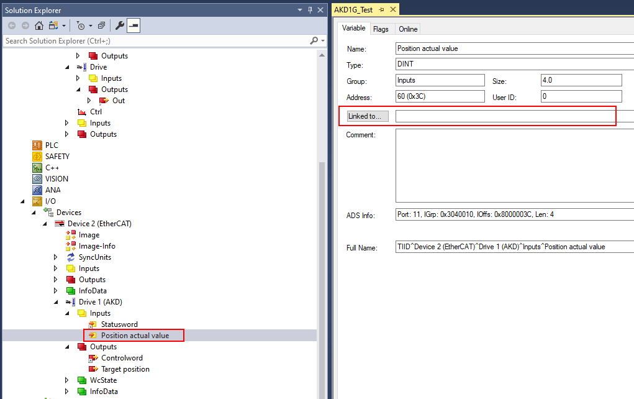
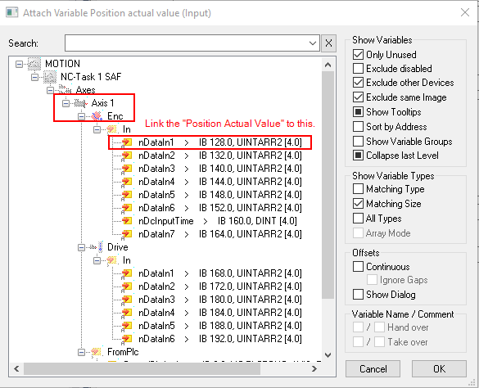
STEP 7: Linking PDOs to NC Task-Axis 1 (Position Actual Value)
Inputs->Position Actual Value
On the left below shows the Link (no link) for Position Actual Value
When clicking the “Linked To” button the right window appears showing the appropriate link to the NC Task-Axis 1.
Link the input to the NC Task-Axis 1 as shown and click OK.

Slide 27
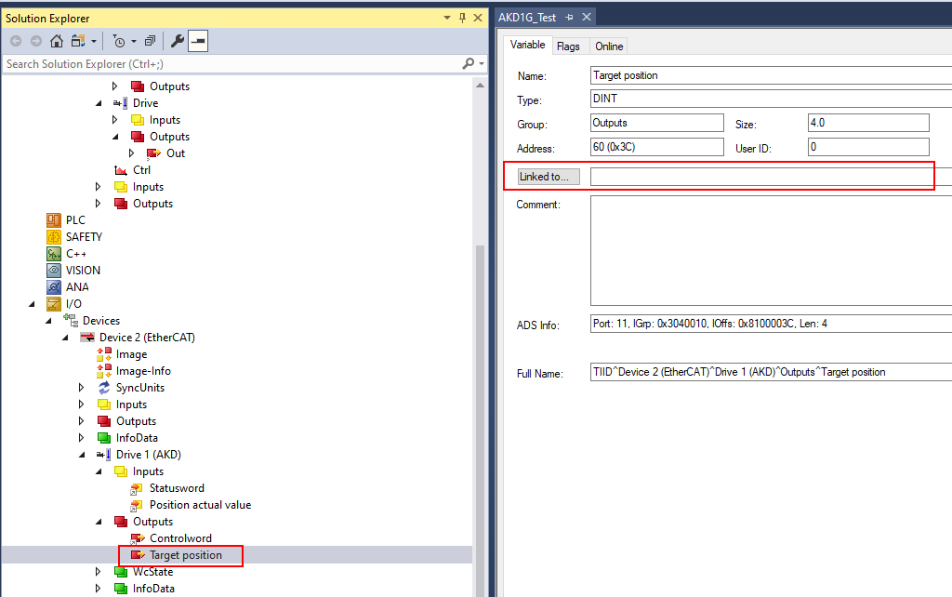
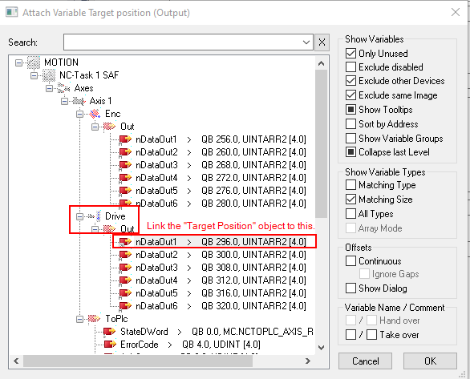
STEP 7: Linking PDOs to NC Task-Axis 1 (Target Position)
Outputs->Target Position
On the left below shows the Link (no link) for Target Position (object 607Ah ).
When clicking the “Linked To” button the right window appears showing the appropriate link to the NC Task-Axis 1.
Link the Target Position (output) to the NC Task-Axis 1 as shown and click OK.

Slide 28
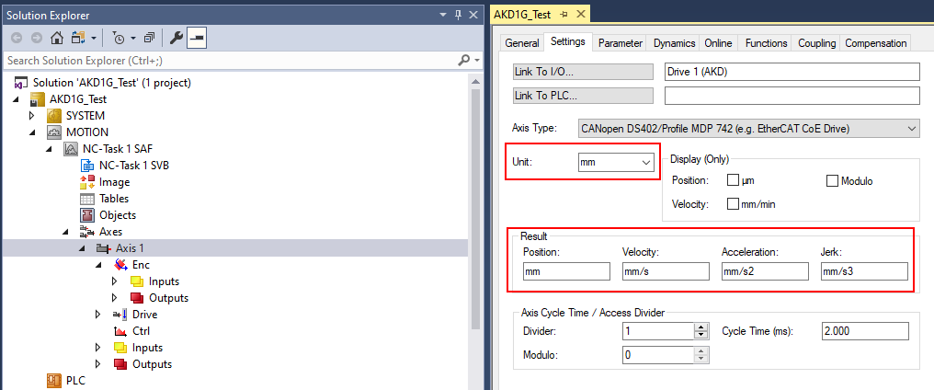
STEP 8: Set Axis Units and Scaling
Under NC-Task->Axes->Axis 1 click the “Settings” tab. The default Unit is “mm” which will be used.

Slide 29
STEP 8: Set Axis Units and Scaling
Under NC-Task->Axes->Axis 1->Enc click the “Parameter” tab. The Scaling Factor Numerator and Denominator are shown with default values. These were changed to 5mm and 1048576 in the default presentation and procedure.

Slide 30
STEP 8: Set Axis Units and Scaling
Recall in step 4 DS402 scaling was set where 5000 represents x.xxx mm where 5000 = 5.000 mm or ( mm x 1000).

Slide 31
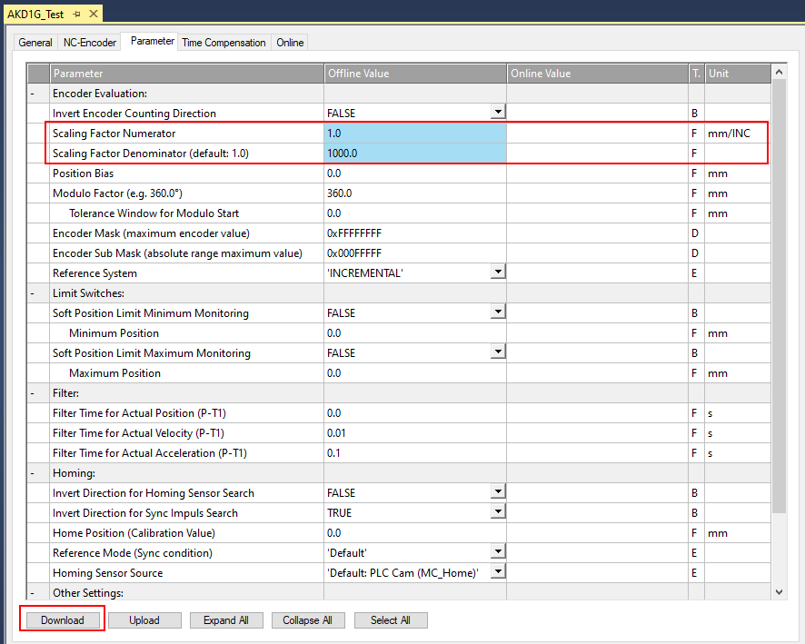
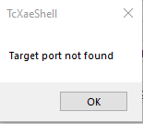
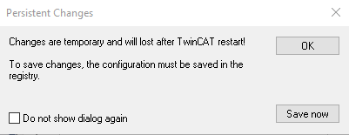
STEP 8: Set Axis Units and Scaling
To change the scaling in TwinCAT3 to agree with the DS402 scaling:
The Scaling Factor Numerator is in mm for TwinCAT3 which will be set to 1 mm (in this example).
The Scaling Factor Denominator will be set to 1000 (equivalent to the 1000 units per rev or (mmx1000) in EtherCAT units for the AKD drive. This scaling convention uses the fact the DS402 feed was set to 5000 to represent 5000 mmx1000.
Click OK on the Download button (bottom left) and then OK on Target port not found and then Save now button on the Persistent Changes pop-up window (both on the right).

Slide 32
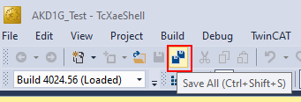
STEP 9: Save Project

Slide 33
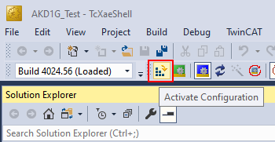
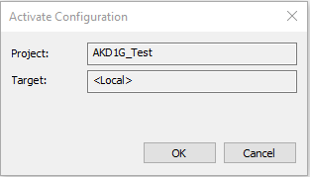
STEP 10: Generate Mappings, Activate Config, Restart in Run Mode
Right-click “Mappings” in the Solution Explorer and click “Generate Mappings”.
Activate Configuration in the toolbar and click ok.

Slide 34
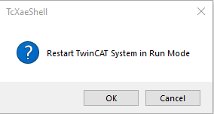
STEP 10: Generate Mappings, Activate Config, Restart in Run Mode
Click OK to start run mode.
The TwinCAT3 status bar shows “Ready” on the left and the icon on the right increments numerical indicating the TwinCAT3 project is running.

Slide 35
STEP 11: Enabling and Generating Motion from the Console
First note in Workbench the axis is inactive and SW (software enable) is off but the drive is ready to be enabled.
PL.CMD (position command) and PL.FB (position feedback) are added to the Watch window in Workbench for convenience

Slide 36
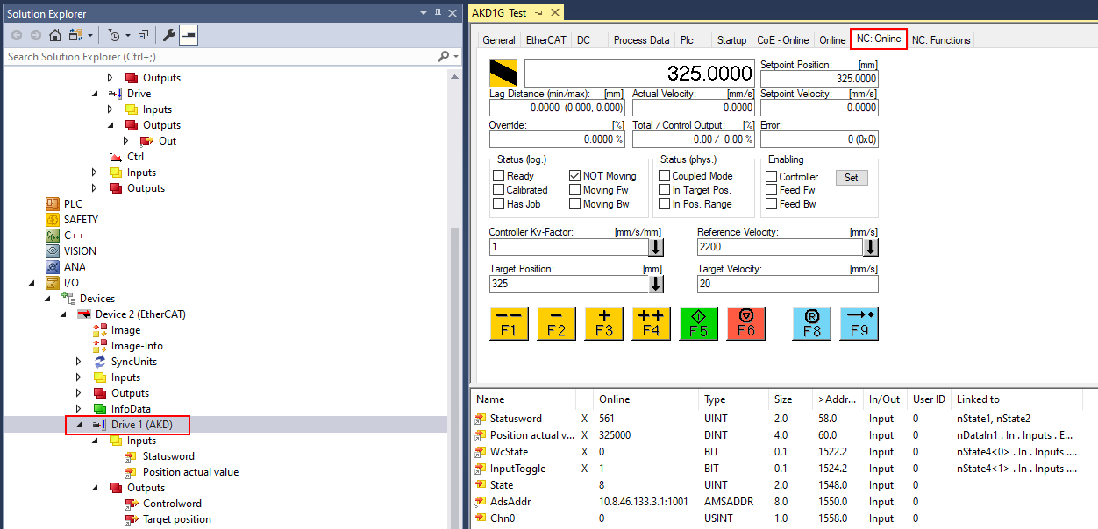
STEP 11: Enabling and Generating Motion from the Console
Navigate to the Console in TwinCAT3 by clicking on the AKD drive in the Solution Explorer and then click on the NC-Online tab.

Slide 37
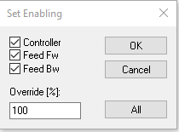
STEP 11: Enabling and Generating Motion from the Console
Enable the drive by click the “Set” button under Enabling in the Console and Click on All then OK.
The Workbench status bar indicates the axis is enabled.

Slide 38
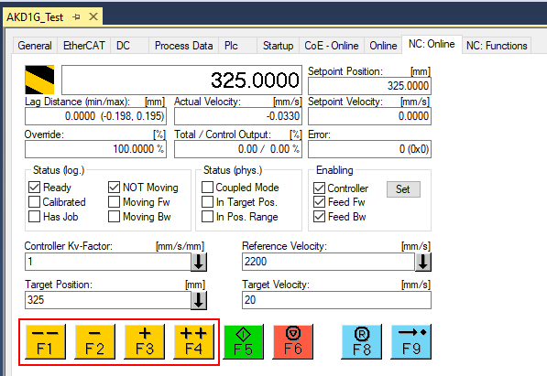
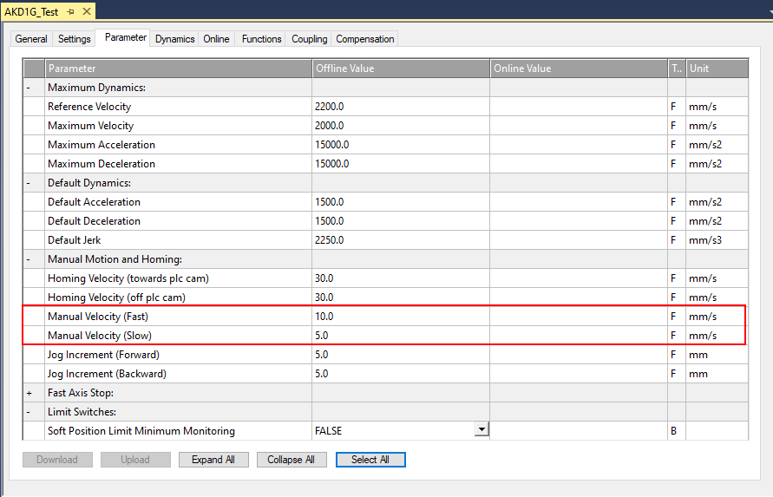
STEP 11: Enabling and Generating Motion from the Console
Jogging from the Console.
The +/- buttons Jog Forward or Reverse at the Manual Velocity (Slow) rate.
The ++/-- buttons Jog Forward or Reverse at the Manual Velocity (Fast) rate .
These rates can be changed under NC-Task->Axes->Axis 1->Parameter Tab.

Slide 39
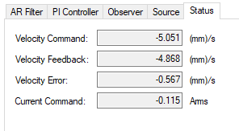
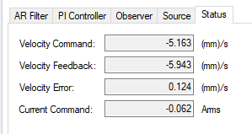
STEP 11: Enabling and Generating Motion from the Console
With F3 (+) held down and monitoring in Workbench under Axis 1->Velocity Loop->Status tab the axis jogs at the velocity of +5 mm/s
With F2 (-) held down and monitoring in Workbench under Axis 1->Velocity Loop->Status tab the axis jogs at the velocity of -5 mm/s

Slide 40
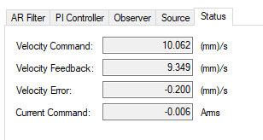
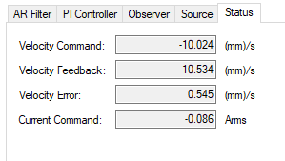
STEP 11: Enabling and Generating Motion from the Console
With F4 (++) held down and monitoring in Workbench under Axis 1->Velocity Loop->Status tab the axis jogs at the velocity of +10 mm/s
With F1 (--) held down and monitoring in Workbench under Axis 1->Velocity Loop->Status tab the axis jogs at the velocity of -10 mm/s

Slide 41
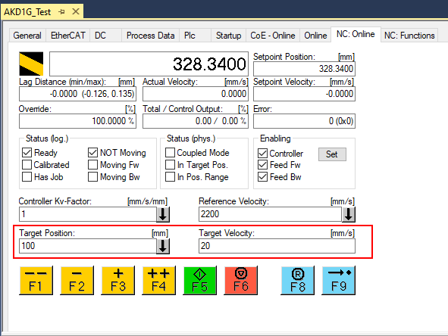
STEP 11: Enabling and Generating Motion from the Console
Making a positional move from the Console.
For this demonstration, a target velocity of 20 mm/s and a target position of 100 mm are entered.
Keep in mind the accel/decel settings in the NC-Task->Axes->Axis 1 are used. Adjust if necessary.
Press the F5 (green) button to start the move and watch the position actual in the Console.

Slide 42
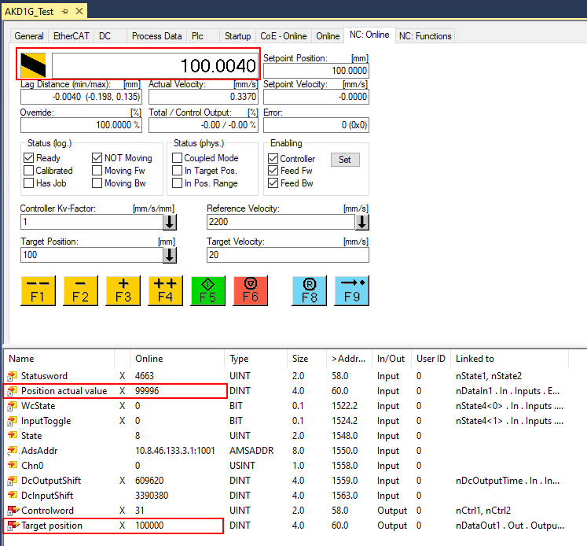
STEP 11: Enabling and Generating Motion from the Console
The Console Position Actual goes to 100 mm and below the console the online values are shown where Position actual and Target Position are both 100000.
This emphasizes the PDO data are scaled in mmx1000 by virtue of the DS402 scaling and not based on 2^x counts as with interpolated position mode.
Note the Watch window in Workbench shows PL.CMD and PL.FB equal to 100.000 mm.

Slide 43
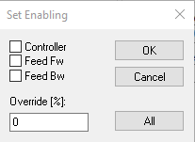
STEP 11: Enabling and Generating Motion from the Console
Disable the axis by clicking the Set button under Enabling in the Console.
Uncheck all 3 checkboxes and set the Override % to zero and click OK.
From the Workbench Status bar the axis is now disabled.

