Slide 1
Profinet RT with the AKD
Training and Overview, with Siemens TIA Portal
Rev. F (minor updates)
Apr 20, 2023
Jimmy Coleman

Slide 2
Reference Sources
Profinet Documentation
Manual – AKD Profinet Communications Manual
Manual – AKD Profinet Sample Project Manual
KDN Articles
KDN – AKD Profinet Fieldbus Support Landing Page, including sample projects
Software
Simatic Step7 TIA Portal V13, V14, and V15 (currently working with V16 and V17)

Slide 3
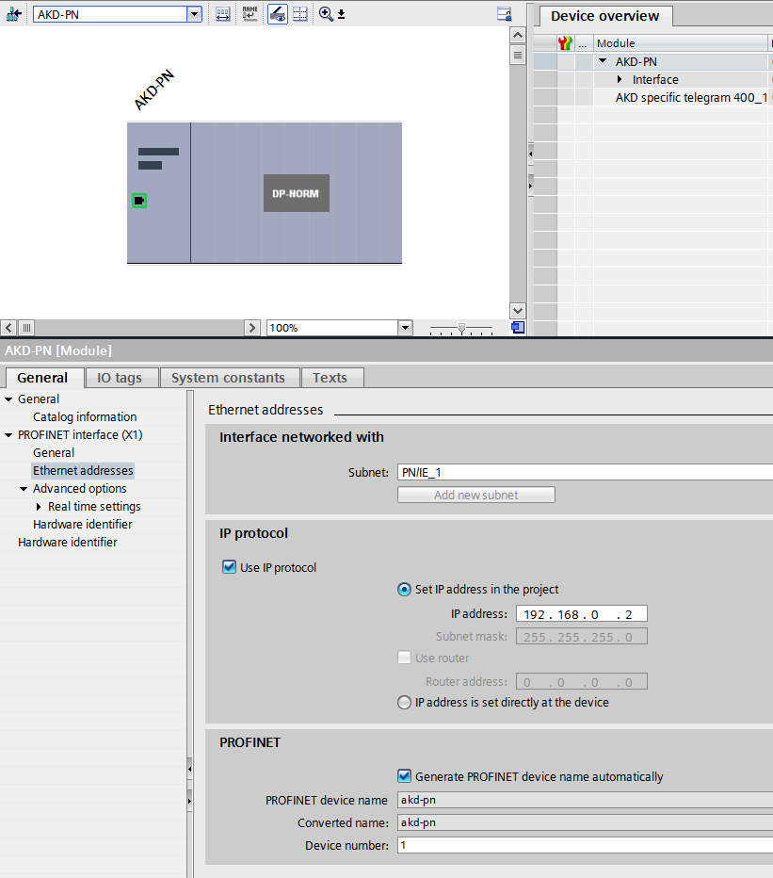
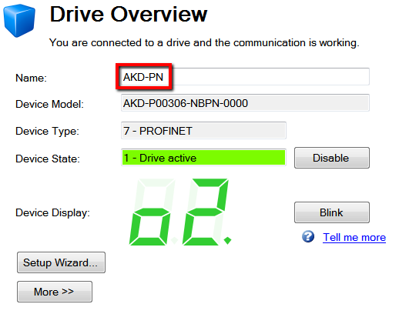
Profinet Communication Settings
Port:
Profinet RT communication on the AKD drive is handled through the Service Port. That is the X11 Ethernet port that is used for communication with the Workbench software. Workbench uses ASCII commands over Telnet communication. It is possible to communicate via Profinet and Telnet at the same time from the same PC.
TCP/IP:
The AKD is identified over Profinet communication by the IP address of the drive and the name of the drive (the drive name in Workbench).
Firmware:
This document is based on firmware version 1-16-00-002.
(Currently FW 1-20-00-001)

Slide 4
Profinet Baud Rate
Baud Rate Settings:
Automatic
16ms (update: now 8ms) (from GSDML file)
Set the baud rate to “Automatic” for best results. The GSDML file sets the baud rate to 16ms.
You can set the baud rate with a “Fixed update time”, but if you do, the PLC will not reconnect to the drive after the drive is power cycled.
If the baud rate is set any faster than 8ms (shorter time), then the communication buffer will fill up and the drive will fault.

Slide 5
AKD Command Source with Profinet
When the AKD drive is in Position Mode, the command source will be “Service”.
When the drive is in Velocity Mode, the command source will be “Fieldbus”.
Service for Position mode (Telegrams 7, 9, 352, 353, and 400)
Fieldbus for Velocity mode (Telegrams 1, 350, and 351)
The command source is based on where the actual motion command is generated. With the AKD in position mode and running motion tasks, the motion command is coming from the Command Generator in the drive. The PLC sends the values for the motion task, but the incremental/instantaneous command is from the drive itself. In velocity mode, the motion command is coming directly from the PLC.
The command source will be set automatically based on the telegram that is being used.
The operation mode must be set either in Workbench (DRV.OPMODE) or by using the “Parameter Access” channel from the PLC (PNU 930). The operation mode will not automatically be set based on the telegram selection.

Slide 6
Telegrams
The Profinet RT communication protocol uses a telegram consisting of up to 12 words (16 bits each) for command setpoints and 12 words (16 bits each) for status.
Velocity Mode:
Standard Telegram 1
Manufacturer Specific Telegrams 350 and 351
Position Mode:
Standard Telegram 7 and 9
Manufacturer Specific Telegrams 352 and 353
Free-mappable Telegram 400
The position commands are sent to Motion Task 0 in the AKD.
The telegram is specified in the PLC hardware configuration. When communication is established between the PLC and the AKD drive, the PLC sets the telegram number in the AKD. You can read the telegram number that has been configured by the PLC in FBUS.PARAM01. Even though this is not a read-only parameter, setting the value of this parameter will not configure the telegram number. It should be treated as read-only.
The telegram number can be changed by the PLC program using PNU 922 (in the Parameter Access channel).
Each telegram contains the Control Word and the Status Word. Profinet uses a State Machine as described in the manual.

Slide 7
Control Word (STW1)
As a quick start, the bits of the Control Word should be used in the following sequence for enabling the drive and starting motion. As each bit is turned on or off, the other bits must be maintained in their current state.
Turn on bit 10 (allow PLC control), then turn on bit 1(coast stop function), then turn on bits 2, 4, and 5 (stop and pause functions) in any order, then turn on bit 0 (ready for enable), then turn on bit 3 (enable), then use either bit 6, 8, 9, or 11 (depending on the desired function) to start motion.
Sequence to enable:
Turn on bit 10
Turn on bits 1 and 2 in any order (both control the SW disable as a stop function)
Turn on bits 4 and 5 in any order (stop and pause of motion task in position mode; controls acc/dec in velocity mode)
Turn on bits 0 and 3 in any order (bit 0 is enable/disable; bit 3 is enable and allow motion commands / disable)

Slide 8
Free Mapping a Telegram
Use Telegram 400 for free mapping. The manual says to use Telegram 0, but 400 is better. TG400 is similar to TG0, but it defines the data size more appropriately. TG400 has available 12 words (16 bits each) for commands and 12 words (16 bits each) for status.
The telegram is mapped using PNU 915 for the command words and PNU 916 for the status words. Each subindex of these PNU’s correspond to the order of the data in the telegram. The value that is used to map specific data to each word is called a signal number. The available signal numbers are listed in the manual. You can free-map a telegram with any data that has a Signal number.
Default mapping for Telegram 400:
PNU 915 for the commands and setpoints:
For Word 1, Write PNU 915 subindex 0 = 1 (for STW1)
For Word 2, Write PNU 915 subindex 1 = 32 (for SATSANW)
For Word 3, Write PNU 915 subindex 2 = 3 (for STW2)
For Word 4, Write PNU 915 subindex 3 = 34 (for MDI_TARPOS)
For Word 5, (this will automatically be the lower 16 bits of MDI_TARPOS)
For Word 6, Write PNU 915 subindex 4 = (for MDI_VELOCITY)
For Word 7, (this will automatically be the lower 16 bits of MDI_VELOCITY)
For Word 8, Write PNU 915 subindex 5 = 36 (for MDI_ACC)
For Word 9, Write PNU 915 subindex 6 = 37 (for MDI_DEC)
For Word 10, Write PNU 915 subindex 7 = 38 (for MDI_MOD)
Add more by writing to the next subindex.
PNU 916 for the status and actual values:
For Word 1, Write PNU 916 subindex 0 = 2 (for ZSW1)
For Word 2, Write PNU 916 subindex 1 = 33 (for AKTSATZ)
For Word 3, Write PNU 916 subindex 2 = 4 (for ZSW2)
For Word 4, Write PNU 916 subindex 3 = 28 (for XIST_A, PL.FB)
For Word 5, (this will automatically be the lower 16 bits of PL.FB)
Add more by writing to the next subindex.

Slide 9
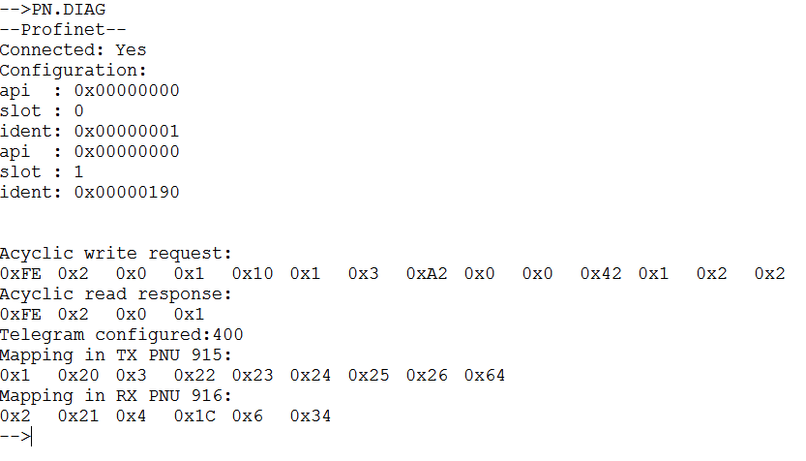
PN.DIAG
The parameter PN.DIAG will output some useful Profinet information in the Workbench Terminal screen. It shows the last acyclic data transmission and the mapping of the current telegram.
Once the Telegram 400 mapping has been written, it can be checked using the parameter PN.DIAG in the Workbench Terminal screen. The mapping data lists the signal numbers in the order of the telegram words. Keep in mind that some data has the size Double Word, and will therefore take two consecutive words in the telegram.

Slide 10
User Units over Profinet
Position Scaling:
PNU# 1002 sets the number of bits per motor rev.
Default is 16 for 2^16 counts per rev.
Velocity Scaling:
2^15 = 100% of maximum speed,
which is 12,000 rpm for the AKD.
So 2^15 = 12,000 rpm
Velocity Mode:
(Profinet Velocity) = (Speed in rpm) * 2^15 / 12000
(Speed in rpm) = (Profinet Velocity) * 12000 / 2^15
Position Mode:
MDI_Velocity = (Speed in rpm) * 2^32 / 12000
Speed in rpm = (MDI_Velocity) * 12000 / 2^32
MDI_ACC = accel in rpm/s * 2^16 / 50,000,000
Accel in rpm/s = MDI_ACC * 50,000,000 / 2^16
Same for MDI_DEC.
Accel and decel in the drive will be in increments of about 763 rpm/s.
Example Command Values in Telegrams 9, 352, 353, and 400:
STW1: Turn on bits: 10, 1 and 2, 0, 3 (enable), 4 and 5, 6 (start motion)
SATZANW1: motion task #. 0x8000 uses MDI move profile data
MDI_TARPOS = DW#16#00010000 = 10000 hex = 65536 counts = 1 rev
MDI_VELOCITY = DW#16#02222222 = 100 rpm
MDI_ACC = W#16#03E8 = 763 krpm/s (rounded to 763,088.448 rpm/s)
MDI_DEC = W#16#03E8 = 763 krpm/s
MDI_MOD: 1 = absolute move; 0 = relative move; (MDI profile only)
MT.CNTL Bits 10 and 11 have been added in FW1-13 beta for control of S-curve acceleration profile.

Slide 11
Parameter Access Channel – Read
Read Parameter Request (from PLC to drive)
Byte | Description | Data Size | Allowable Values | Typical Value
0 | Request Reference | Unsigned 8 bit | 0x00 is reserved; 0x01 - 0xFF | Defined by PLC
1 | Request ID | Unsigned 8 bit | 0x01 Read | Always 0x01
2 | Axis # | Unsigned 8 bit | 0x00 only (AKD Parameter Manager) | Always 0x00
3 | No. of Parameters | Unsigned 8 bit | 0x01 - 0x27 | 0x01
4 | Attribute | Unsigned 8 bit | 0x00 reserved; 0x10 Value; 0x20 Description | Always 0x10
5 | No. of Elements | Unsigned 8 bit | 0x01 - 0xEA | 0x01
6 | PNU Number - upper 8 bits | Unsigned 8 bit | 0x01 - 0xFF | PNU
7 | PNU Number - lower 8 bits | Unsigned 8 bit | 0x01 - 0xFF | PNU
8 | Subindex - upper 8 bits | Unsigned 8 bit | 0x00 only | Always 0x00
9 | Subindex - lower 8 bits | Unsigned 8 bit | 0x00 only | Always 0x00
Read Parameter Response (from drive to PLC)
Byte | Description | Data Size | Allowable Values | Typical Value
0 | Request Reference | Unsigned 8 bit | 0x00 is reserved; 0x01 - 0xFF
1 | Response ID | Unsigned 8 bit | 0x01 Read successful or 0x81 Unsuccessfull | 0x01
2 | Axis # | Unsigned 8 bit | 0x00 only (AKD Parameter Manager) | Always 0x00
3 | No. of Parameters | Unsigned 8 bit | 0x01 - 0x27 | 0x01
4 | Attribute | Unsigned 8 bit | 0x00 reserved; 0x10 Value; 0x20 Description | Always 0x10
5 | No. of Elements | Unsigned 8 bit | 0x01 - 0xEA | 0x01
6 | PNU Number - upper 8 bits | Unsigned 8 bit | 0x01 - 0xFF | PNU number
7 | PNU Number - lower 8 bits | Unsigned 8 bit | 0x01 - 0xFF | PNU number
8 | Subindex - upper 8 bits | Unsigned 8 bit | 0x00 only | Always 0x00
9 | Subindex - lower 8 bits | Unsigned 8 bit | 0x00 only | Always 0x00
10 | Format | Unsigned 8 bit | 0x41 for byte; 0x42 for Word; 0x43 for Dword; 0x00 for no data | 0x41, 0x42, or 0x43
11 | Number of Values | Unsigned 8 bit | 0x01 | 0x01
12 | Data - Most significant | Signed 8 bit | 0x01 - 0xFF | Data
13 | Data | Unsigned 8 bit | 0x01 - 0xFF | Data
14 | Data | Unsigned 8 bit | 0x01 - 0xFF | Data
15 | Data - Least significant | Unsigned 8 bit | 0x01 - 0xFF | Data

Slide 12
Parameter Access Channel – Write
Write Parameter Request (from PLC to drive)
Byte | Description | Data Size | Allowable Values | Typical Value
0 | Request Reference | Unsigned 8 bit | 0x00 is reserved; 0x01 - 0xFF | Defined by PLC
1 | Request ID | Unsigned 8 bit | 0x02 Write | Always 0x01
2 | Axis # | Unsigned 8 bit | 0x00 only (AKD Parameter Manager) | Always 0x00
3 | No. of Parameters | Unsigned 8 bit | 0x01 - 0x27 | 0x01
4 | Attribute | Unsigned 8 bit | 0x00 reserved; 0x10 Value; 0x20 Description | Always 0x10
5 | No. of Elements | Unsigned 8 bit | 0x01 - 0xEA | 0x01
6 | PNU Number - upper 8 bits | Unsigned 8 bit | 0x01 - 0xFF | PNU number
7 | PNU Number - lower 8 bits | Unsigned 8 bit | 0x01 - 0xFF | PNU number
8 | Subindex - upper 8 bits | Unsigned 8 bit | 0x00 only | Always 0x00
9 | Subindex - lower 8 bits | Unsigned 8 bit | 0x00 only | Always 0x00
10 | Format | Unsigned 8 bit | 0x41 for byte; 0x42 for Word; 0x43 for Dword; 0x00 for no data | 0x41, 0x42, or 0x43
11 | Number of Values | Unsigned 8 bit | 0x01 | 0x01
12 | Data - Most significant | Signed 8 bit | 0x01 - 0xFF | Data
13 | Data | Unsigned 8 bit | 0x01 - 0xFF | Data
14 | Data | Unsigned 8 bit | 0x01 - 0xFF | Data
15 | Data - Least significant | Unsigned 8 bit | 0x01 - 0xFF | Data
Write Parameter Response (from drive to PLC)
Byte | Description | Data Size | Allowable Values | Typical Value
0 | Request Reference | Unsigned 8 bit | 0x00 is reserved; 0x01 - 0xFF | Defined by PLC
1 | Response ID | Unsigned 8 bit | 0x02 Read successful or 0x82 Unsuccessfull | 0x02
2 | Axis # | Unsigned 8 bit | 0x00 only (AKD Parameter Manager) | 0x00
3 | No. of Parameters | Unsigned 8 bit | 0x01 - 0x27 | 0x01
10 | Format | Unsigned 8 bit | 0x41 for byte; 0x42 for Word; 0x43 for Dword; 0x00 for no data | 0x00
11 | Number of Values | Unsigned 8 bit | 0x00 | 0x00

Slide 13
PNU Data Size – “Format”
Data Sizes in the Parameter Access Channel are referred to as the Format.
Format = data size of parameter (PNU)
0x41 = Byte
0x42 = Word
0x43 = Dword
The number of bytes in a PNU read response or write request will vary depending on the Format.
0x41 = 1 byte
0x42 = 2 bytes
0x43 = 4 bytes
The previous slides show 4 bytes of data being used, which would be for a PNU parameter with a size of Double Word (32 bits). For a Format of 0x42 (Word), the last two bytes (bytes 14 and 15) would not be used.

Slide 14
Profinet Commands in Workbench
AKD Profinet commands can be used in the Workbench Terminal screen
PN.STW1 – reads the Control Word (STW1)
PN.ZSW1 – reads the Status Word (ZSW1)
PN.POSSCALE – sets scaling for PNU data of position parameters (See the AKD Profinet Manual)
PN.TIMEOUTFTHRESH – reads the time of an F702 fault, based on time of Profinet master
PN.DIAG – reads Profinet connection information, last acyclic transmission, and telegram mapping

Slide 15
Wireshark Filter for Profinet
Display Filter
Show only the PN-IO based traffic:
pn_io
Show the PN-IO based traffic without the cyclic PN-IO telegrams (to avoid a lot of "noise"):
pn_io && !pn_io.ioxs

Slide 16


